Slide 1
Bell Ringer
Welcome to Biology Honors! Below is the Bell Ringer for the day. This should be done quietly and quickly at your desk.
Pick up the 2 pages on the shelf by the door.
Find your assigned seats.
Begin Reading the Syllabus – Sign any forms that ask for a student signature.
Make sure you have a pencil or pen to write with.

Slide 2
Must know procedures-Awesome Arrival
Greeting at the door.
Pick up papers on the shelf
Materials out and Do Now started by the time the bell rings.
Check the notebook set up
Take out your homework to be checked.

Slide 3
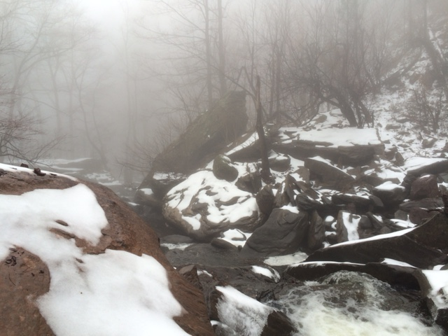
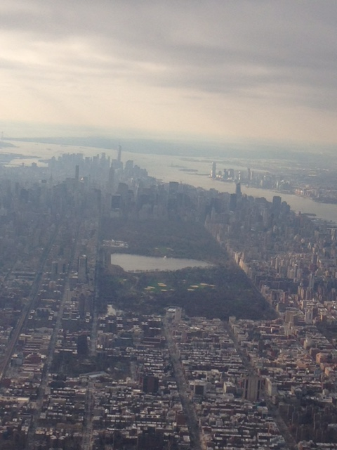
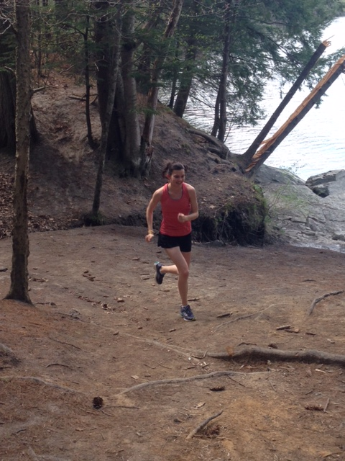
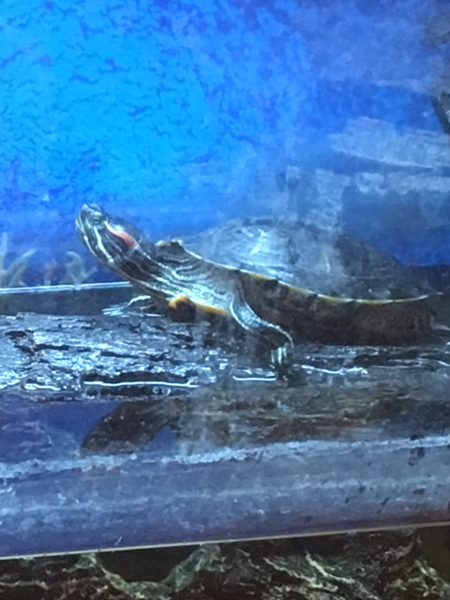
About Me

Slide 4
The Syllabus

Slide 5
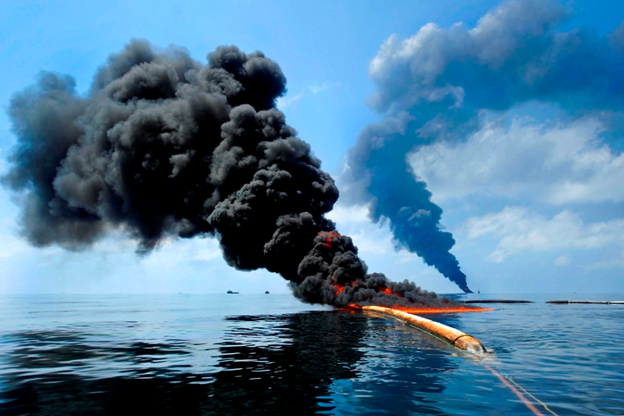
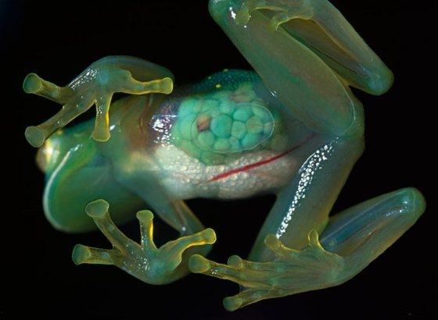
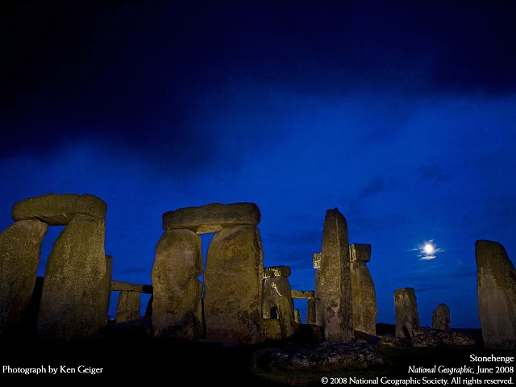
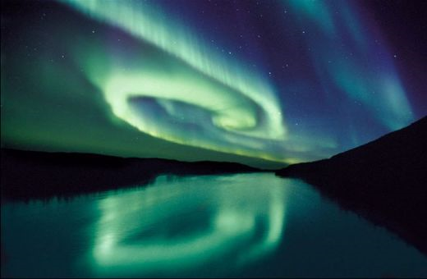
Biology Is the Study of Life

Slide 6
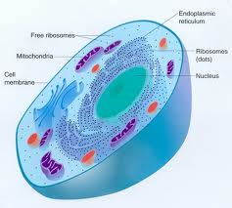
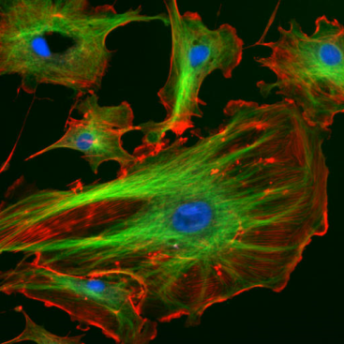
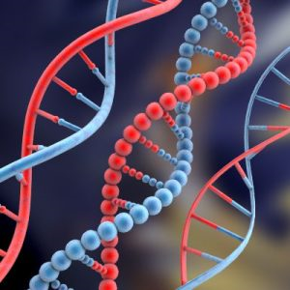
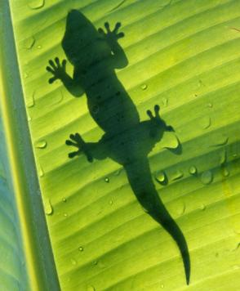
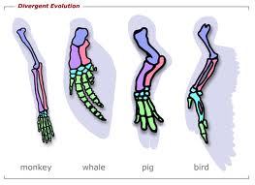
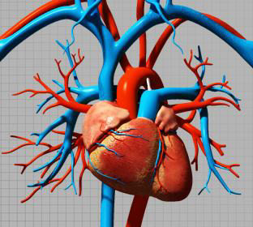
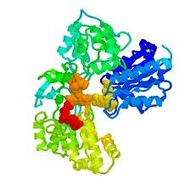
We will study…
Nature of Science
Biochemistry
Cellular Biology
Genetics
Evolution
Ecology
Human Physiology
Post EOC

Slide 7
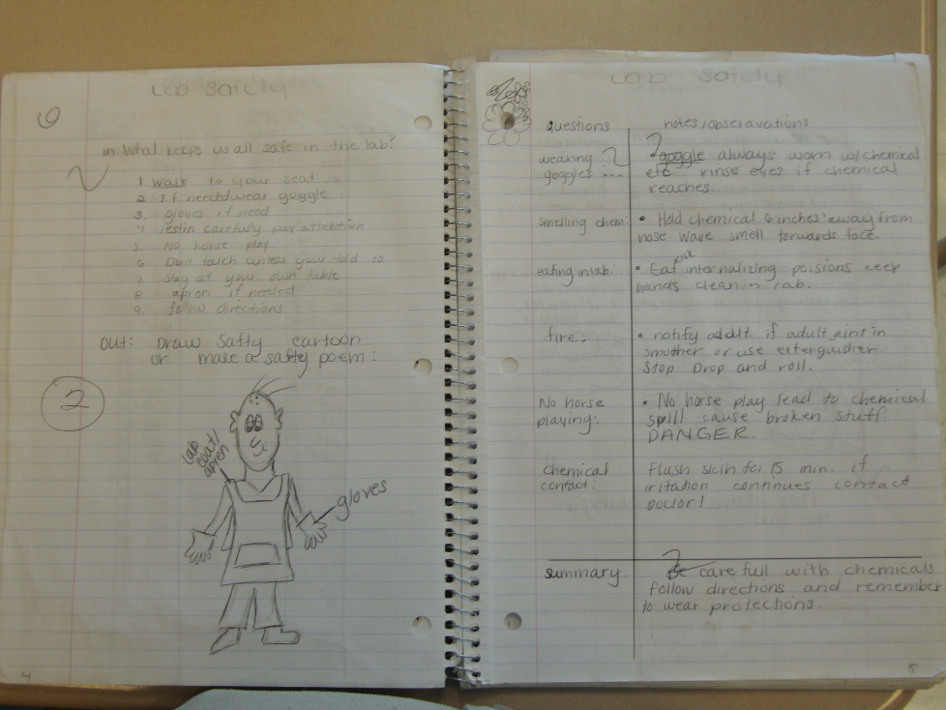
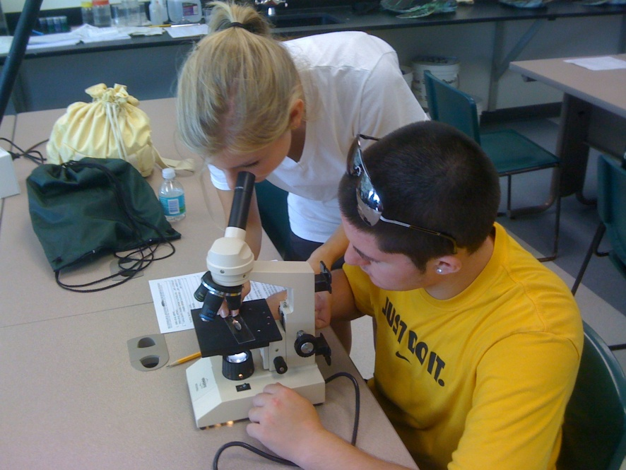
We will…
Complete Labs
Keep an INB

Slide 8
The End of Course Exam
Counts for 30% of your entire grade for the year!
You must pass this class to get a full scholar diploma.
Notes:
We only have about 85 days to prepare for this test and there is a lot to cover. It will take hard work and dedication to pass the test.

Slide 9
OUR CLASSROOM GOALS
100% will pass the End of Course Exam.
80% Mastery on each standard.

Slide 10
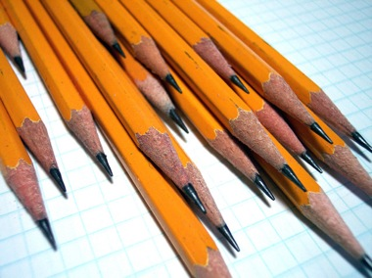
What you will need to succeed:
Interactive notebook- DO NOT LOSE THIS
Wolfson Success Binder and Agenda
Pens or pencils-Ms. Speers will not supply
Notes:
Show examples of each thing they will need.

Slide 11
Grading
Tests 40%
Quizzes 20%
Lab Reports 20%
Projects 15%
Homework 5%

Slide 12
Retake and make up work policy

Slide 13
Homework philosophy
This is a fast paced course covering a lot of material. You will need to practice what we learn in class. It is therefore important that you complete your homework.
Be prepared to have daily homework from biology. Additionally, any class work you don’t finish in class you are expected to complete before the next class period. To summarize, don’t waste time in class and get your work done, or you will have double the homework.
Penda Learning is an online website where you will be expected to complete an assignment per week. The assignments will be due Monday by 11pm. This is in addition to worksheets and projects given in class
Extra credit homework- book work! The chapter assessments will be worth 10 points of extra credit.

Slide 14
Contact Expectations
email: speersa@duvalschools.org
Website: http://wolfsonbiology.weebly.com
Remind app: Text this code….
I will do my best to respond within 24 hrs and I will expect you to do the same.

Slide 15
Classroom Expectations

Slide 16
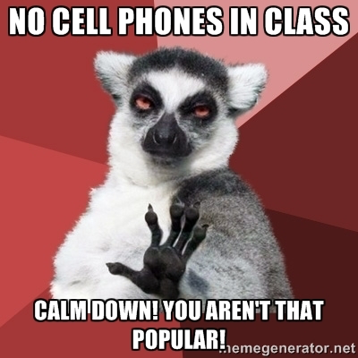
A note about cell phones…

Slide 17
Must Know Procedures
If you need to get my attention or speak you must raise your hand.
College Hand
Notes:
Teach the college hand
Practice the attention getting signal. Time them.
Teach hand signals. Explain bathroom passes.
Model STAR. Have everyone do it. 100% compliance.
Go over cell phone policy

Slide 18
Must Know Procedures
Attention getting signal.
Notes:
Teach the college hand
Practice the attention getting signal. Time them.
Teach hand signals. Explain bathroom passes.
Model STAR. Have everyone do it. 100% compliance.
Go over cell phone policy

Slide 19
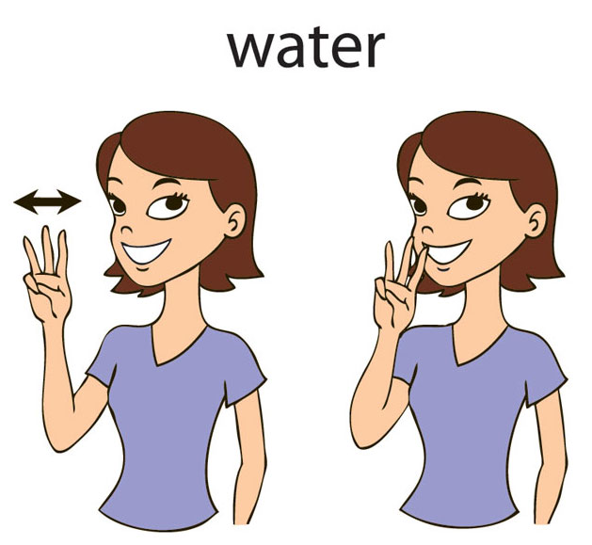
Must Know Procedures
Throwing stuff away, getting tissues, pencils, bathroom passes.
Notes:
Teach the college hand
Practice the attention getting signal. Time them.
Teach hand signals. Explain bathroom passes.
Model STAR. Have everyone do it. 100% compliance.
Go over cell phone policy

Slide 20
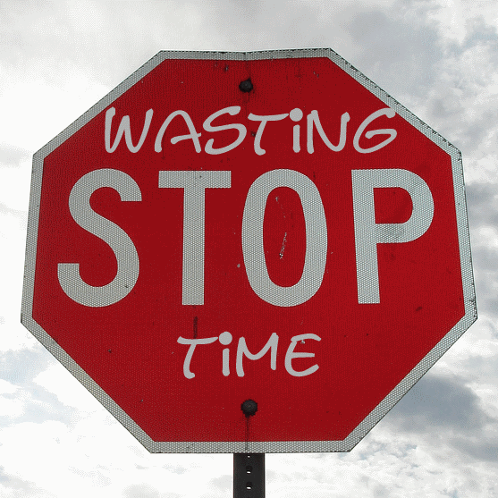
Why do these matter?
We have 10 months of content to cover in about 8.5 months.
If we waste 5 minutes every class period with side conversations and distractions we will eventually lose an entire week of school time.
This will equal lower scores and more homework.

Slide 21
Absences
Missing class is the worst thing you can do for your grade.
IT IS YOUR RESPONSIBILLITY TO GET THE WORK YOU MISSED. The best place is on the biology website and in the master notebook. (NOT your teacher)
You will have one chance to make up a test upon your arrival or you will take an all essay test. (see retake policy)

Slide 22
I can't remember what
we did in class yesterday.
I can't find
my…
notes, homework, old quizzes . . .
I'm sure it’s in . . .
mom’s car . . .
my book bag . . .
my room . . .
I was absent yesterday. Did I miss anything?

Slide 23
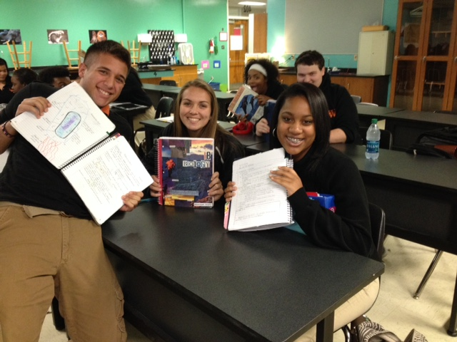

Slide 24
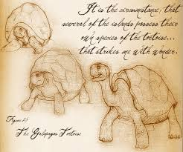
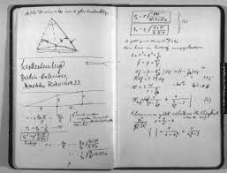
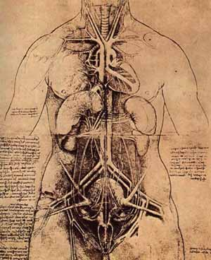
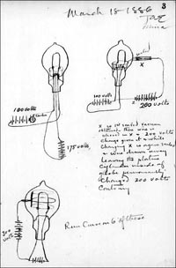
Darwin
Einstein
Leonardo
Edison

Slide 25
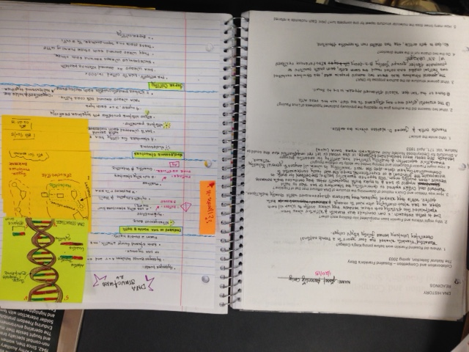

Slide 26
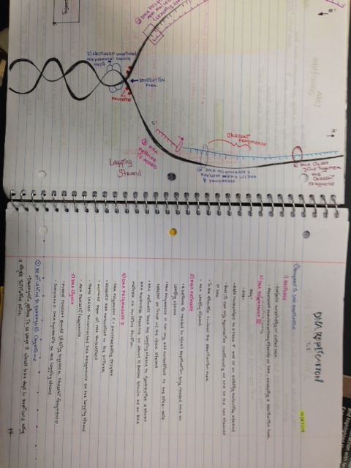

Slide 27
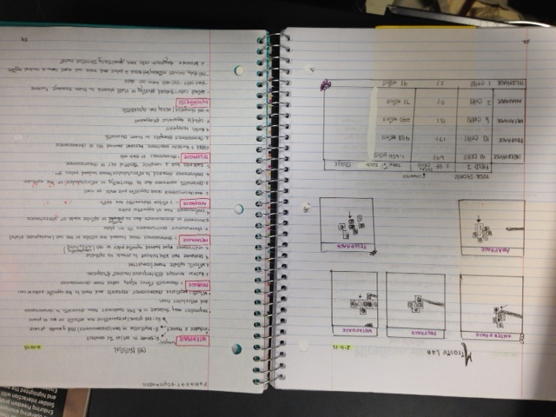

Slide 29
Ready to set-up your own notebook?

Slide 30
Write down your observations
https://www.youtube.com/watch?v=LGAfIx5VQ_M

Slide 31
Observations and Inferences

Slide 32
Observations
An observation is the gathering of information by using our five senses
See
Smell
Hear
Taste
Feel
Notes:
Students will take notes in T-chart form with observations on one side and inferences on the other

Slide 33
Observations
There are two types of observations
Qualitative-describe what we observe (quality)
Quantitative- measures what we observe (numeric)
Examples:
Ms. Speers has green eyes
Ms. Speers has two eyes

Slide 34
Inferences
Inferences are an explanation for an observation you have made
They are based on your past experiences and prior knowledge.
Inferences are often changed when new observations are made.
Again, observations are information we gather directly through our five senses… inferences help explain those observations.

Slide 35
Examples…
OBSERVATION: The grass is wet.
POSSIBLE INFERENCES:
It rained
The sprinkler was on
There is dew on the grass
A dog urinated on the grass
All of these inferences could possibly explain why the grass is wet. They are all based on prior experiences.

Slide 36
And Another…
OBSERVATION: The school fire alarm is going off.
POSSIBLE INFERENCES:
The school is on fire
We are having a fire drill
A student pulled the fire alarm
Again, these are all logical explanations for why the fire alarm is going off

Slide 37
Last one…
OBSERVATION: A student is sitting in the main office.
POSSIBLE INFERENCES:
?
Why might a student be sitting there?

Slide 38
Did you really make observations about the penguin video?
Write-pair-share
Did you write down observations or inferences?
Notes:
Students will write I or O next to their “observations” stating if they actually wrote down observations or inferences from the video.

Slide 39
Bubble Gum Lab
Lab expectations and safety measures?
Notes:
Teacher can record on white board what students say about safety and add their own expectations

Slide 40
Why did we conduct this lab on the first day of class? What do we need to know?
Scientific Method
Independent and Dependent Variables

Slide 41
Scientific Method
Identify a testable question
State a hypothesis
Conduct an experiment
Analyze data
Draw conclusions
Share results
Repeat as needed
Notes:
Have students add this under notes on observations and inferences

Slide 42
Independent and Dependent Variables
Independent variable: it is independent, it does not change when the other variables change
Dependent variable: it changes based on the value of the independent variable
Notes:
Students will write down these definitions under scientific method notes

Slide 43
What are the Independent and Dependent Variables?
The time it takes to run a mile depends on the person’s running speed
The higher the temperature of the air in the oven, the faster a cake will bake
Lemon trees receiving the most water produced the most lemons
Students measure the temperature of the water at different depths in the St. John’s river and found that the temperature varied.

Slide 44
What are the Independent and Dependent Variables?
Mr. Krabbs wants to make Bikini Bottoms a nicer place to live. He has created a new sauce that he thinks will reduce the production of body gas associated with eating crabby patties from the Krusty Krab. He recruits 100 customers with a history of gas problems. He has 50 of them eat crabby patties with the new sauce and 50 eat them with the old sauce.
Which sauce they are eating
How much gas is produced

Slide 45
What is Science?
Science is limited to studying only the problems of the natural world that can be understood by using the processes of science (Scientific Method).

Slide 46
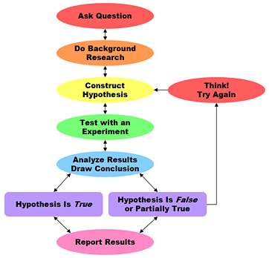
Characteristics of Science
Scientists deal with natural phenomena (events) which can be observed, measured and tested by scientific methods; they must be able to use their senses to observe and evaluate.
Scientific theories are always subject to change.
Notes:
Students will add to notes the statement in bold

Slide 47
CONPTT
What is this?
Notes:
How to tell if its science or not. Give students the CONPTT handout. Go through the next section as time permits.

Slide 48
Consistent
Results same time after time.
No contradiction.

Slide 49
Reality Check
Green plants grow towards light source.
Walking under a ladder causes bad luck.
Using consistency-which statement is a scientific one?

Slide 50
Observability
The event-observed and explained.
Use human senses.

Slide 51
Reality Check
Some plants eat meat.
Extraterrestrial beings have visited Earth.
Using observability, which statement above is a scientific one?

Slide 52
Natural
A natural cause explains what happened.

Slide 53
Reality Check
Green plants convert sunlight into energy.
By picking up a penny (heads up), you will have good luck all day.
Using the idea of Natural, which of the statements is a scientific one?

Slide 54
Predictability
Make specific predictions.
Predictions can be tested.

Slide 55
Reality Check
Without light, green plants will die.
If you are a “Scorpio”, today’s horoscope says you will receive money.
Thinking of Predictability, which statement is a scientific one?

Slide 56
Testability
Must be testable through processes of science.
Controlled experimentation.

Slide 57
Reality Check
The “Bermuda Triangle” causes ships and planes to sink and disappear.
Life comes from life and cannot come from non-life.
Using the testability, which statement above is a scientific one?

Slide 58
Tentativeness
Science does not have all the answers or solutions.
Theories can be modified.

Slide 59
Reality Check
The number of human chromosomes was once know to be 48 now it is 46.
Living things were once grouped into two categories. Now there are six categories since criteria has changed.
Based on tentativeness, which statement is a scientific one?

Slide 60
What is Science?
Limited to natural world- use scientific processes
Offers explanations for events-subject to revision(tentative)
Not able to answer all the questions in the universe, nor solve all the problems

Slide 61
Non-Science
Does not meet the criteria of CONPTT.
Topics may be very logical.
Example-philosophy, personal opinions, ethics.
False Science
Pseudoscience-non science, sometimes portrayed as a legitimate science.
Example-astrology.

Slide 62
Exit Ticket
Answer the questions and hold on to the exit ticket paper
It will be collected when everyone is done

Slide 63
Homework:
Go over the syllabus with your parents/guardian.
Tear off the last sheet and return it
Keep the first two pages in your binder
Due Next Class:
Bring back the signed last page of your syllabus. (front and back!)
Complete Nature of Science worksheet
Notes:
Write this on the syllabus.

Slide 64
Excellent Exit
Check to make sure homework is written down in your agenda
Check your desks and the room. All materials must be cleaned and put away in the proper location.
The bell does not dismiss you. I will dismiss you when everyone is silently in their seats.

