Slide 1
Day 1

Slide 2
Bell Ringer- complete on page in notebook
Carmen conducted an experiment to determine if listening to different types of music would affect a person’s pulse. Her hypothesis was that pulse rate would change with different types of music. Each person listened to seven different selections of music for 30 seconds each. Each person’s pulse was taken before the music and then after each 30-second interval of music. The pulses were taken again after the music selections were completed. Based on her experiment, Carmen concluded that a person’s pulse rate changed when the person listened to different types of music. Which component is missing from Carmen’s experiment?
A. a question C. a control group
B. a hypothesis D. description of the experiment

Slide 3
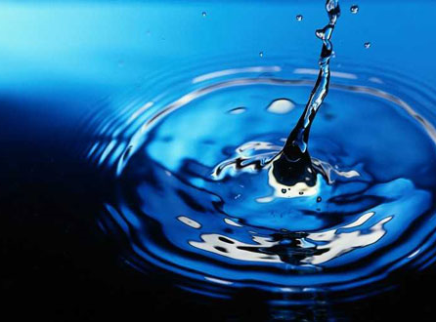
Properties of water

Slide 4
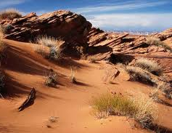
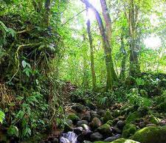
The Importance of Water
All living things need water, so as biologists we need to understand how it acts.
We will continue to practice our lab skills of making observations and collecting data.
A
B

Slide 5
Learning Goals
I will be able to:
Explain the concept of polarity in terms of negative and positive charges in water
Distinguish between covalent bonds and hydrogen bonds.
Describe the following properties of water: cohesion, adhesion, expansion upon freezing, solubility, and temperature moderation.
Justify why the properties of water make life possible

Slide 6
Take Notes!
https://www.youtube.com/watch?v=0eNSnj4ZfZ8

Slide 7
Page in notebook
Properties of Water
Polarity and Hydrogen Bonds
Hydrogen Bond Definition:
Polarity Definition:
Adhesion
Def:
Caused by:
Effect on Life:
Cohesion
Def:
Caused by:
Effect on Life:
Density
Def:
Caused by:
Effect on Life:
Moderates Temp
Def:
Example:
Effect on Life
Solubility
Def:
Caused by:
Effect on Life:

Slide 8
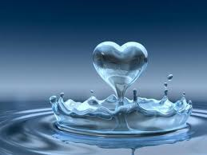
Key Points
All living things need water to survive.
The unique structure of the water molecule determines it’s unique properties.

Slide 9
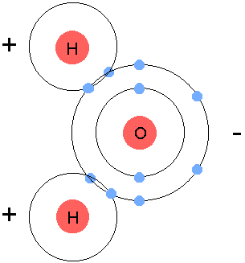
What is the Structure of a Water Molecule?
  1. Water is composed of 1 oxygen atom and 2 hydrogen atoms.
  2. The oxygen has a negative charge and the hydrogen has a positive charge.
  3. The hydrogen atoms are always in the “ear” position.
  Draw this in your notes

Slide 10
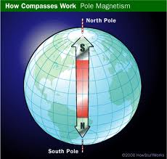
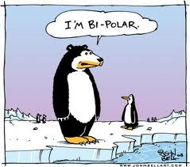
Why is water polar?
H20 is polar b/c it has a slightly + and a slightly – end.
Polarity- n. The state of having 2 opposite ends.
  What else has a positive and negative end?
  When else do we use the word polar?

Slide 11
Practice
Which diagram of a water molecule is correct?
  Choose the answer AND explain why.
A
B
C
D

Slide 12
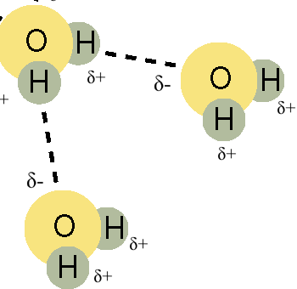
What is Hydrogen Bonding?
The bond between the O and H atoms of different water molecules.
  The positive H is attracted to the negative O.
  Hydrogen bonds are very weak.
  Draw this…

Slide 13
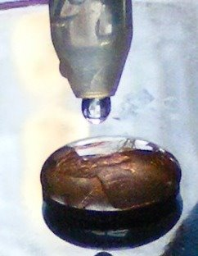
Explore with Pennies!
What property of water was this?

Slide 14
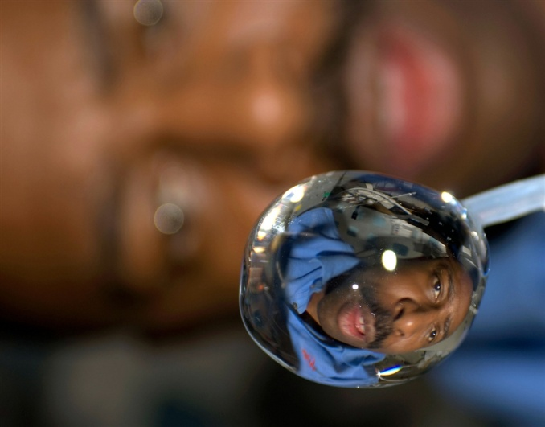
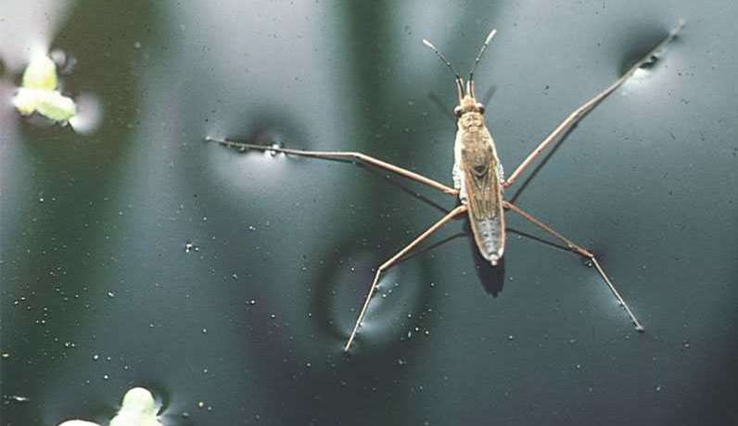
What is Cohesion?
Cohesion is the attraction of water molecules to each other.
  Co= together (ex: cooperate, covalent etc.)
  “hesion”= to stick
Surface Tension

Slide 15
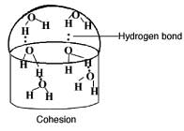
What causes cohesion?
Hydrogen bonds hold together the water molecules.

Slide 16
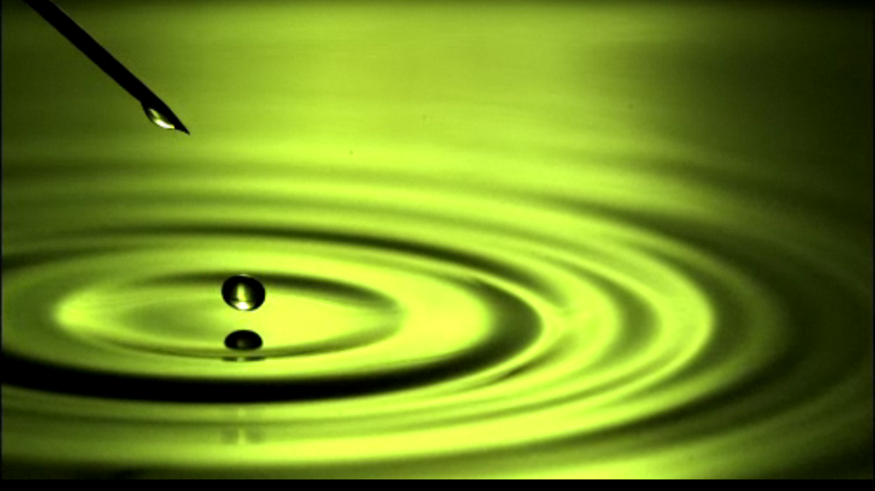
Water
Notes:
Click on the picture for a Discovery Channel link.
A water droplet falls as a sphere because of surface tension. That same tension can keep it from breaking and even allow it to bounce off a miniscule layer of air!

Slide 17

What is Adhesion?
Adhesion is the attraction of water molecules to other substances.
Adhesion is also caused by hydrogen bonds.
How does water get to the top of the tree if I only watered the soil?

Slide 18
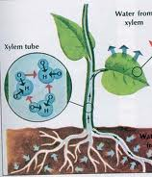
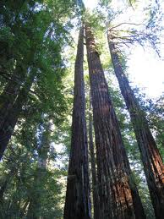
The water sticks to the inside!
Video

Slide 19
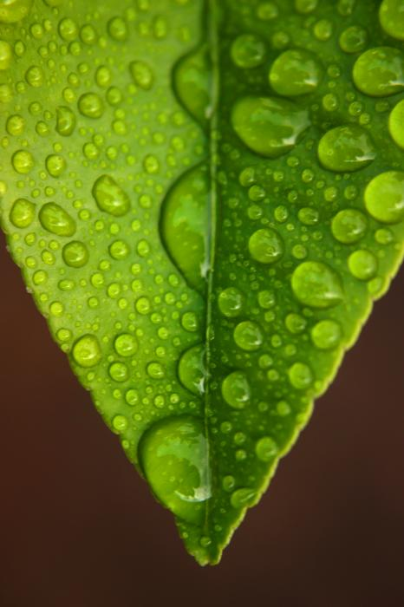
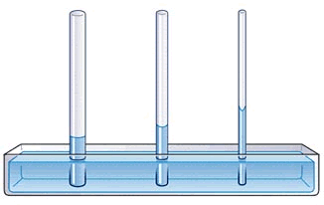
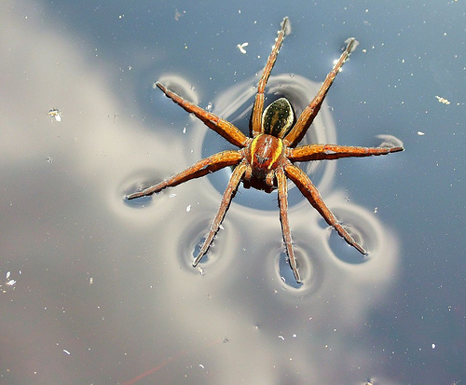
Practice with Adhesion & Cohesion (whiteboard)
What property of water does this each picture represent?
1.
2.
3.

Slide 20
Practice with Adhesion & Cohesion
4. What does “co-” mean?
.
5. What property of water allows water spiders to walk across the surface of a pond?
.
6. Why is water able to move against gravity?

Slide 21
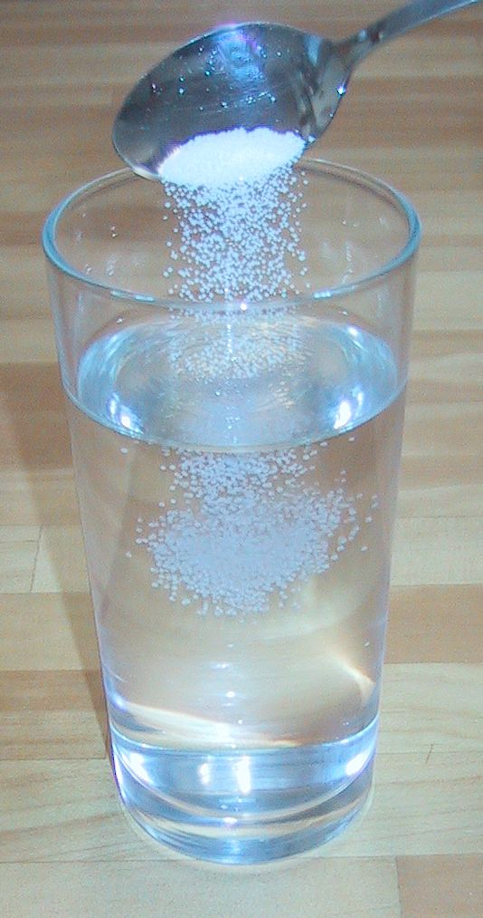
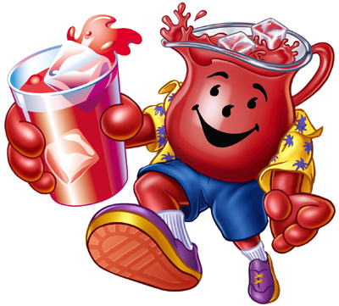
What is Solubility?
A. Solubility is the ability of substances to dissolve in water.
  Water is called the universal solvent because it can dissolve almost anything!

Slide 22
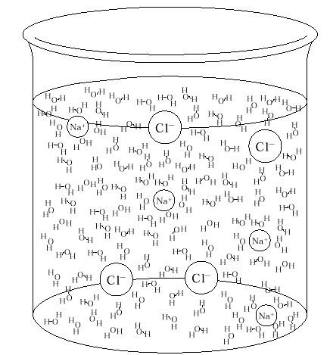

Why is water such a great solvent?
Because the positive and negative ends act like magnets that pull apart other substances.
*Animated Biology

Slide 23
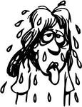
How does solubility impact life?
We are 70% water! Most our tissues are full of water that has substances dissolved in it.
Why do you think tears and sweat are salty?

Slide 24
What is Density?
Density is how tightly packed the atoms in a substance are.
  Objects with greater density will sink.
  Objects with smaller density will float.

Slide 25
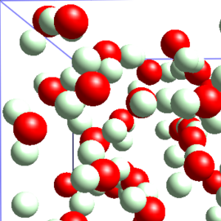
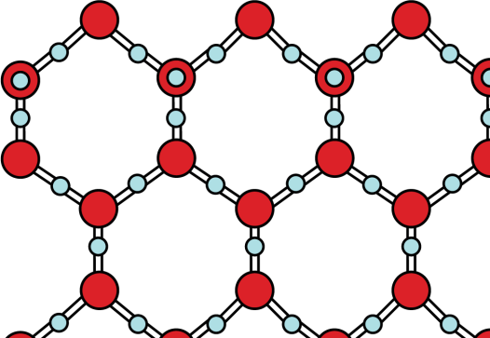
Is ice less dense than water? Why?
Ice, unlike most solids, is less dense than water.
Because Hydrogen bonding creates more space between water molecules so they spread out.
*Animated biology
Liquid Water Solid Water (ICE)

Slide 26
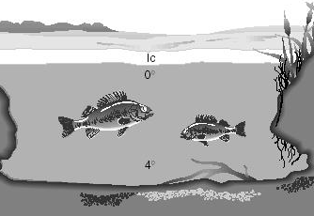
Why does water density impact life?
Floating ice will keep the water underneath warm.
  This allows fish and other organisms to survive in the winter.
  What would happen to pond life if ice was more dense?

Slide 27
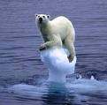
How does water density impact life?
Many animals in the arctic live on ice.
ex: polar bears, seals, (What else?)

Slide 28
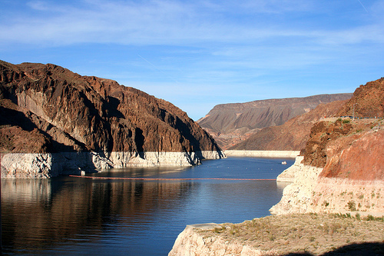
Why does water moderate temperature?
It takes a lot of energy to change the temperature of water.
Water can protect an ecosystem from extreme temperature differences.
In the picture, what is going to heat up and cool down faster? Land or water?

Slide 29
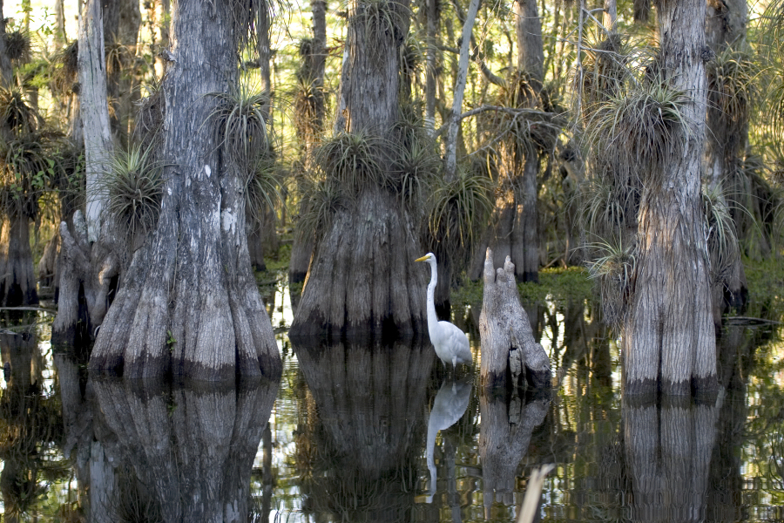
Rank the following in the order which they will cool down at night: Air, plants, water, soil.

Slide 30
We Do- Read article whole class
We will popcorn read an article
I will call on people randomly to answer the accompanying questions
Everyone needs to be paying attention and quietly writing down the answers as we go over them

Slide 31
Exit Ticket!!!
Complete silently and independently
When completed, sit quietly until Ms. Speers collects them
Don’t use your notes or your neighbor

Slide 32
Homework-Water Project
Complete the project due next class (first thing during bell ringer it will be collected)
The rubric is attached to the assignment description
It will go in as a project grade (15% of total grade)
Be creative with this one!
Additionally, your first quiz is 8/22 (A) and 8/23 (B) one week away! It will be on the Nature of Science and Properties of Water

Slide 33
Day 2

Slide 34
Bell Ringer on page in notebook and turn in the water project
Water is essential for life. Its special properties make water the single most important molecule in plant life. Which of the following properties of water enables it to move from the roots to the leaves of plants?
A. Water expands as it freezes.
B. Water is an excellent solvent.
C. Water exhibits cohesive behavior.
D. Water is able to moderate temperature

Slide 35

Lab Safety Reminders

Slide 36
Lab Groups:

Slide 37
Lab Instructions
Follow the directions at each station for the lab
You will have 15 mins per station and then you will rotate as a lab group to the next station
There will be a timer on the board so you know how much time you have left
Raise your hand with any questions

Slide 38
Done with the lab?...Not yet
Points will be taken off of the class grade if the lab area is not clean and ready for the next class
Now comes the analysis part– answer the post lab questions on your lab handout
Let’s review the major parts of this lab together!

Slide 39
Homework
Finish any post lab questions you didn’t complete in class
Study for your first quiz, which is next class!
  The quiz will be on the Nature of Science and Properties of Water
  Quizzes are worth 20% of your overall grade

