Slide 1
Day 1

Slide 2
Bell ringer-complete on page
At what point in the cell cycle does DNA replication occur and why?
A. before a cell divides, to provide each of the two resulting cells with a complete set of DNA instructions
B. before a cell divides, to ensure that the DNA will fit into the resulting cells
C. during cell division, to ensure that the DNA will fit into the resulting cells
D. after a cell divides, to provide each of the two resulting cells with a complete set of DNA instructions

Slide 3
https://www.youtube.com/watch?v=h5mJbP23Buo

Slide 4
Warm-Up!
Use the following decoder to decipher ONE of the following codes at the top of page 54.
1) TCGGACTACCGA
2) AGCCTTTACGGG
3) CCATACACCCAT
GAC = Christian GGG = Best
CGA = Awesome TAG = High
CAT = Cool CTT = Wales
TCG = Texas AGC =Lake
TAC = Is CCA = Biology
UCC = The ACC = So

Slide 5
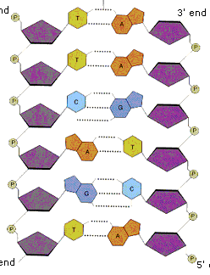
Remember-DNA is a CODE
DNA is a code for many different proteins.
We need proteins to make up most of our bodies.
We use Enzymes to decode the DNA.

Slide 6
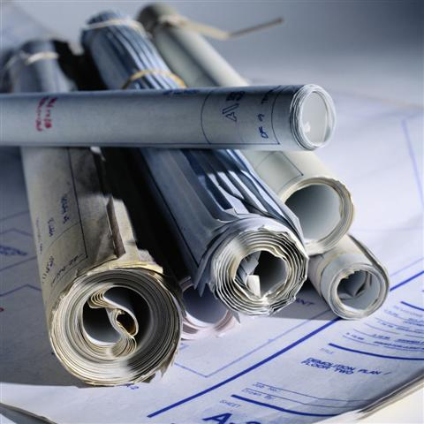
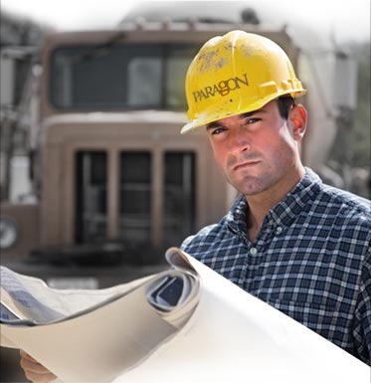
Key Point #1-DNA must be transcribed.
DNA is too important to leave the nucleus, so in order to make proteins, RNA must be made.
RNA = ribonucleic acid (transcription of DNA)
We call this process Transcription because the DNA code is being transcribed.
Imagine you are an architect of a very special building, would you let your only set of blue prints leave with the builder?

Slide 7
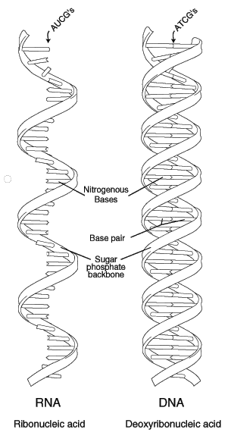
Key Point #2-Structure of RNA
RNA is much like DNA however:
  it only has one strand.
  Instead of using the nucleotide Thymine (T) it uses Uracil (U). (A=U)
  RNA uses the sugar ribose while DNA uses the sugar deoxyribose.

Slide 8
* Hint: remember…
RNA
loves
“U”
RNA uses Uracil instead of Thymine.

Slide 9
Practice:Write the RNA strand for one of these DNA strands in your notes:
DNA
GAATTACA
CCAATTAG
ATAGACAG
CCAGTACA
RNA
CUUAAUGU
GGUUAAUC
UAUCUGUC
GGUCAUGU

Slide 10
Compare and Contrast DNA and RNA
Fill in the Venn Diagram on page
Draw a picture of DNA and RNA in the correct location
contains genetic information
double stranded
single stranded
A=U
A=T
used in DNA Replication
uses the sugar ribose
uses the sugar deoxyribose
used in transcription
Can leave the nucleus
cannot leave the nucleus
made up of phosphates, sugars and nitrogen bases
use G, C and A

Slide 11
DNA Both RNA
double stranded
A=T
uses the sugar deoxyribose
cannot leave the nucleus
used in DNA Replication
-both are used in transcription
-made up of phosphates, sugars and nitrogen bases
-contain genetic information
-use G, C and A
single stranded
A=U
uses the sugar ribose
Can leave the nucleus
used in translation

Slide 12
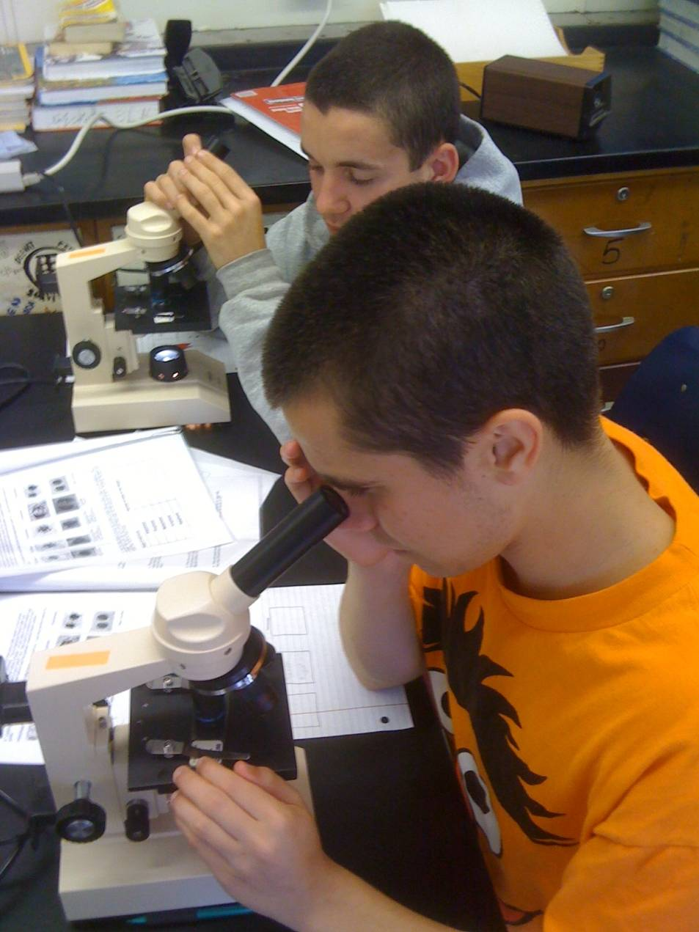
Ok got it, so there is only 1 type of RNA?
Actually, there are 3 types of RNA!

Slide 13
Key Point #4-There are 3 types of RNA involved in protein synthesis.
Name | Function | Picture
Messenger RNA (mRNA) | Carries info found in DNA out of the nucleus
Transfer RNA (tRNA) | Brings amino acids to the ribosome during translation to help make the protein
Ribosomal RNA (rRNA) | Makes up ribosomes ; it gives the mRNA a place to attach to during translation

Slide 14
Practice with Transcription
Let’s practice transcription! I’ll give you one strand of DNA, and you complete the complementary strand of RNA. (Remember, in RNA replace T with U).
DNA strand: ATT AGG CCG GAT TAG CCT ATT
RNA strand: UAA UCC G
DNA strand: ATT GCA TTA TCG ATT ATC CTA
RNA strand:

Slide 15
Practice with Transcription
Let’s practice transcription! I’ll give you one strand of DNA, and you complete the complementary strand of RNA. (Remember, in RNA replace T with U).
DNA strand: ATT AGG CCG GAT TAG CCT ATT
RNA strand:UAA UCC GGC CUA AUC GGA UAA
DNA strand: ATT GCA TTA TCG ATT ATC CTA
RNA strand: UAA CGU AAU AGC UAA UAG GAU

Slide 16
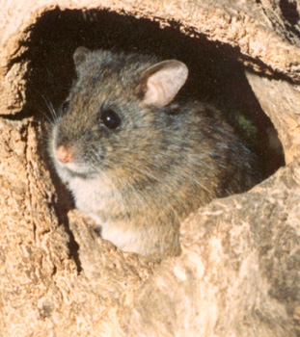
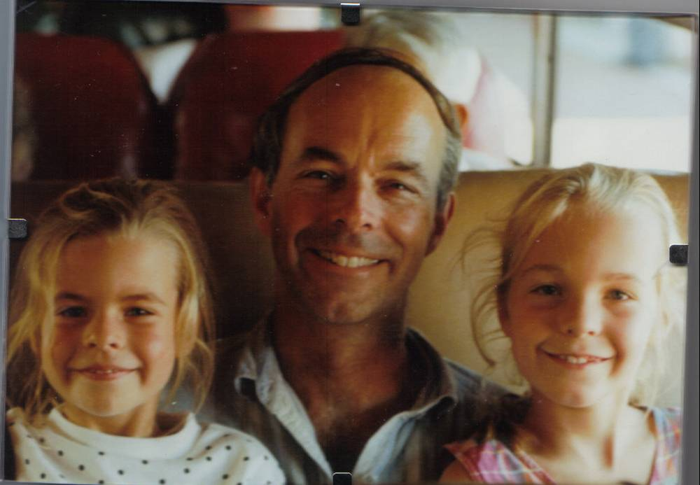
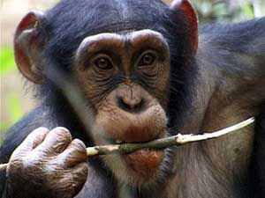
DNA Fun Fact!
Human beings have roughly 99.1 percent of our genes in common with the chimpanzee, our closest relative on earth. The overlap between mice and humans is surprisingly close, too. We have nearly 75 percent of our genes in common.

Slide 17
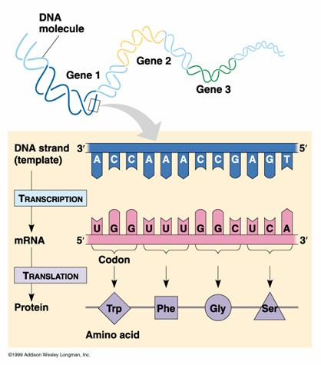
Key Point #3 Translation turns mRNA into a Protein
Last class we used Transcription to turn
DNA RNA.
Today, we are going use Translation to turn RNA Protein.

Slide 18
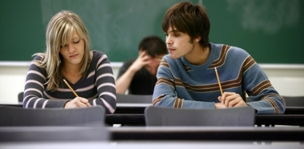
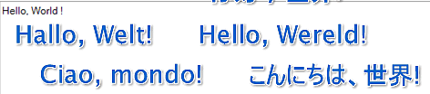
Hint to remember…
You transcribe something when you want a similar copy. (like when you transcribe your neighbors work…)
You translate something when you want to turn it into a different language.

Slide 19
TRANSLATION STEP 1
After transcription, mRNA leaves the nucleus and attaches to the ribosome where translation begins.
Translation: mRNA is turned into amino acids which fold to make proteins.
Translation
Amino Acid chain
1 mRNA

Slide 20
In order to make the amino acid chain in translation, the mRNA is “read” with each set of three nucleotides acting like a word.
Each of these 3 letter words is called a codon, and different codons code for different amino acids.
Ex: AUG=amino acid methionine
GCA=amino acid alanine
(3 nucleotides=1 codon=1 amino acid)

Slide 21
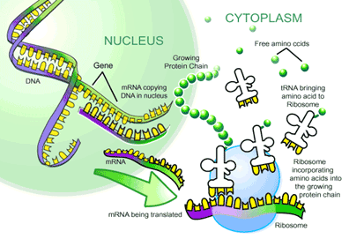
mRNA to Protein

Slide 22
Translation Video
http://www.youtube.com/watch?v=-zb6r1MMTkc&feature=related&safety_mode=true&persist_safety_mode=1

Slide 23
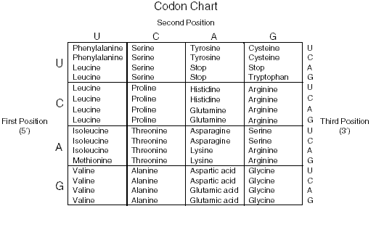
Scientist figured out the codes for the 20 amino acids that make up proteins! We can use this chart to decode RNA.
2nd Nucleotide
1st Nucleotide
3rd Nucleotide

Slide 24
How to use a Codon chart.
Figure out the codon you want to use. They are always 3 letters from mRNA.
Find the first letter on the LEFT side.
Find the second letter on the TOP.
Find the third letter on the RIGHT side.
Hint: Left→ Top → Right

Slide 25
Scientist figured out the codes for the 20 amino acids that make up proteins! We can use this chart to decode RNA.
2nd Nucleotide
1st Nucleotide
3rd Nucleotide

Slide 26
Translation Practice
-Let’s practice translation! I’ll give you the mRNA strand, and you figure out what amino acids it codes for. (Remember, 3 nucleotides=1 amino acid)
mRNA strand: AUG CCC UUU GAG AAG CGU UAA
amino acid chain: ex: methionine-histidine
mRNA strand: AUG GGG UGG AGA AGU GUG UGA
amino acid chain:
mRNA strand: AUG AGU AAC CCA UAA
amino acid chain:

Slide 27
Translation Practice
mRNA strand: AUG CCC UUU GAG AAG CGU UAA
amino acid chain: methionine–histidine–phenylalanine–glutamate–lysine-arginine-stop
mRNA strand: AUG GGG UGG AGA AGU GUG UGA
amino acid chain: methionine-glycine-tryptophan-arginine-valine-stop
mRNA strand: AUG AGU AAC CCA UAA
amino acid chain: met ser asp pro stop

Slide 28
Diagram Practice
What processes does 1, 2, 3, 4, and 5 stand for?
What is this diagram showing?

Slide 29
Practice Time!
Work in your lab groups to complete as much of the worksheet as you can
We will review the questions in 20 minutes

Slide 30
Exit Ticket
Silently and independently complete your exit ticket

Slide 31
Home Learning
Worksheet is due next class
Study for quiz on DNA replication and protein synthesis in one week

Slide 32
Day 2

Slide 33
Bell ringer- complete on page
Large bodies of water, such as lakes and oceans, do not quickly fluctuate in temperature. What is the reason for this phenomenon?
A. Water is an acid.
B. Water is a versatile solvent.
C. Water has a high heat capacity.
D. Water acts as a buffer.

Slide 34
Take notes!
https://www.youtube.com/watch?v=gG7uCskUOrA

Slide 35
Lab Instructions
Work with your normal lab group
The “nucleus” is the lab side of the classroom
When you think you are done, make sure you answered all the post lab questions and cleaned up your area. Remember, if I have to clean up after you, you will get points taken off!

Slide 36
Exit Ticket
Silently and independently complete your exit ticket

Slide 37
Home Learning
Post lab questions are due next class
Study for quiz in two class periods!

Slide 38
Day 3

Slide 39
Bell ringer-complete on page
What will most likely happen if an appropriate enzyme is added to a chemical reaction?
A. The reaction rate will increase.
B. The equilibrium of the reaction will be maintained.
C. The reaction rate will decrease.
D. The reaction will stop.

Slide 40
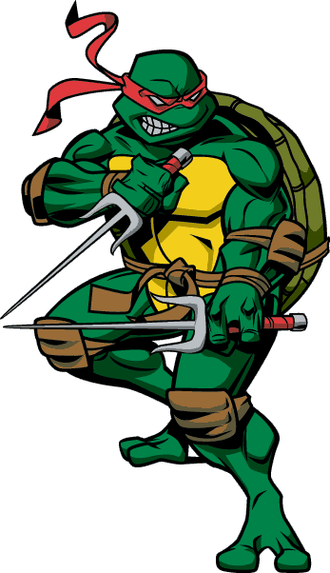
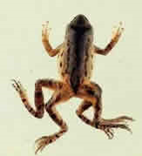
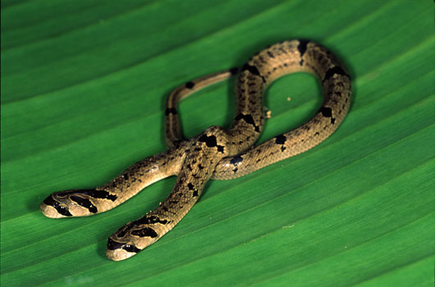
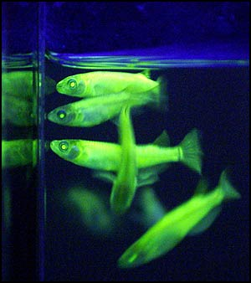
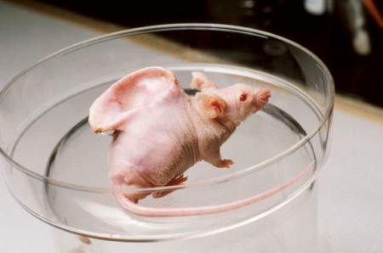
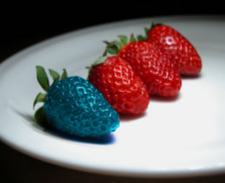
Mutations
What do you think caused these things to happen?

Slide 41
These changes can be cause by 2 things:
1) Mutations- Changes in DNA that affect genetic information.
2) Genetic Engineering – the process of making changes in the DNA code of living organisms.
1st we are going to talk about mutations…

Slide 42

Warm Up
1. Use the following “codon chart” to decipher the code (just like before) UCUGACCCAAACUGA
2. What does it say if a mistake is made and a letter changed? UCUGACCCAAACUGU
3. What does it say if a codon is deleted?
UCUGACCCAUGU
GAC = Christian GGG = Best
UGA = Awesome TAG = High
CAT = Cool CTT = Parker
UCU = Texas UGC = Terry
AAC = Is CCA = University
UCC = The ACC = So

Slide 43
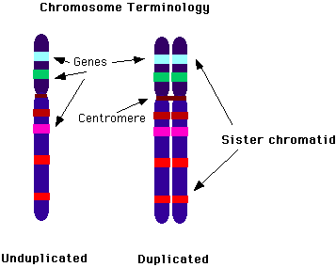
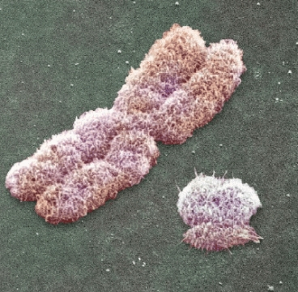
There are 2 types of mutations…
Gene mutations
Chromosomal mutations

Slide 44
What Causes Mutations?
There are two ways in which DNA can become mutated:
  Mutations can be inherited.
    Parent to child
  Mutations can be acquired.
    Environmental damage (UV light, radiation such as X-rays, chemicals in food, water, air, buildings, etc).
    Mistakes when DNA is replicated (DNA Polymerase makes mistakes about once every 100,
    Mistakes during crossing over - exchange of DNA between chromosomal segments.

Slide 45

Gene Mutations
There are 3 types of Point mutations: Substitution, Insertion and Deletion
Point Mutations – changes in a single nucleotide of DNA
  Substitution
  Example:
    THE FAT CAT ATE THE RAT
    THE FAT HAT ATE THE RAT

Slide 46
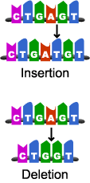
Gene Mutations
Frameshift Mutations – single base is inserted or deleted from DNA, causing a shift in the reading of the codons. The protein may not be able to perform its function.
  2. Insertion
    THE FAT CAT ATE THE RAT
    THE FAT HCA TAT ETH ERA T
  3. Deletion
    THE FAT CAT ATE THE RAT
    TEF ATC ATA TET GER AT
H

Slide 47
Which type of mutation?
THE BAT HAS A HAT → THE CAT HAS A HAT
THE BAH ASA HAT
THE BAT HAS A HAT → THE BAT HAS A RAT
THE ABA THA SA HAT
THE BAT STOP →

Slide 48
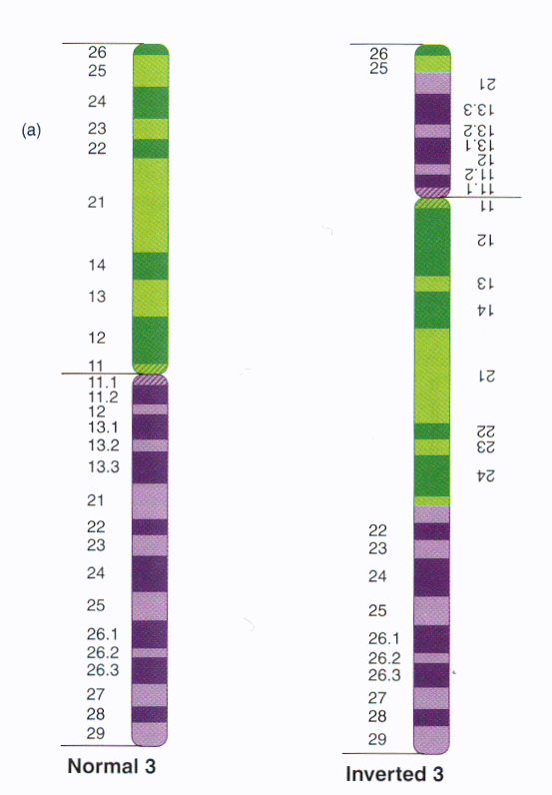
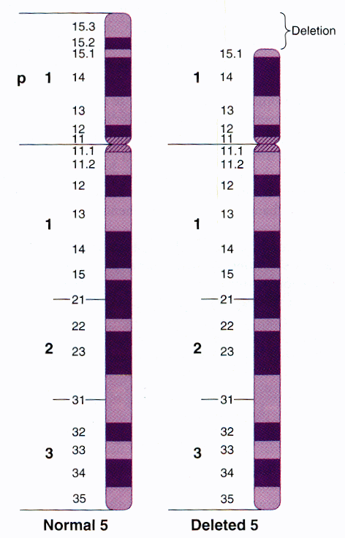
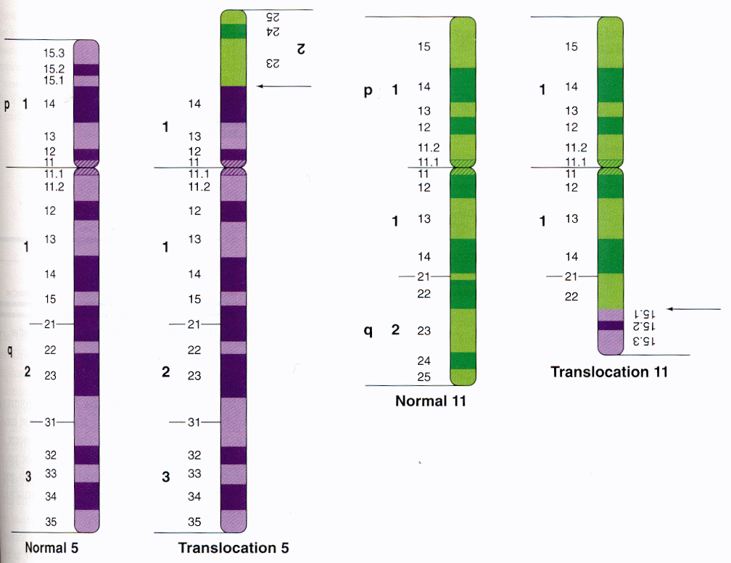
Chromosomal Mutation
Changes in number and structure of entire chromosomes
Deletion
Inversion
Translocation

Slide 49
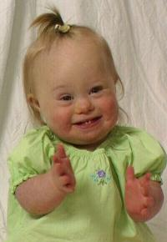
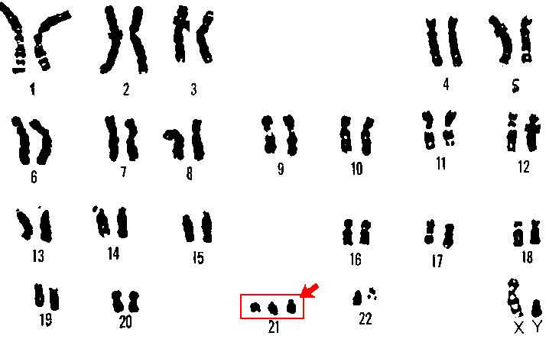
Chromosomal Mutations
Down Syndrome
  Chromosome 21 does not separate correctly.
  They have 47 chromosomes in stead of 46.
  Children with Down Syndrome develop slower, may have heart and stomach illnesses and vary greatly in their degree of intelligence.

Slide 50
Role of mutation
Mutation is not all bad!
Occurs at a high rate in all our cells and does NOT always have negative effects
No mutation
  population cannot change and adapt to new conditions
Random changes in DNA sequence
beneficial changes in phenotype
natural selection
evolution of population

Slide 51
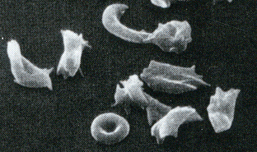
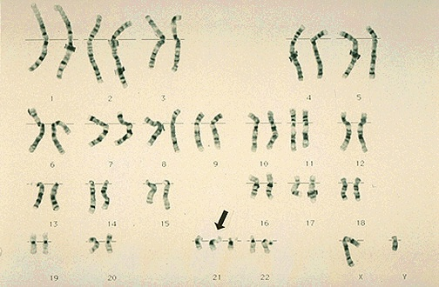
Role of mutation in disease
Mutation always has the potential to cause disease:
Single amino acid change in hemoglobin causes sickle cell anemia
Down syndrome is caused by a third copy of chromosome 21
Cancer occurs when mutations cause cells to grow in an uncontrolled way

Slide 52
Snork Synthesis
You will work with your lab group to complete the Snork Synthesis activity
Pay attention to the changes in transcription and translation that are caused by mutations
Have the teacher check your work before you say you are done, it is important to get this right! Last chance to work on these topics before the quiz, so make sure you ask for help if you need it!

Slide 53
Review Time
Anchor chart of DNA replication and protein synthesis!!!

Slide 54
Home Learning
Study for quiz on DNA replication and protein synthesis next class!!

