Slide 1
Mitosis
Asexual Reproduction

Slide 2
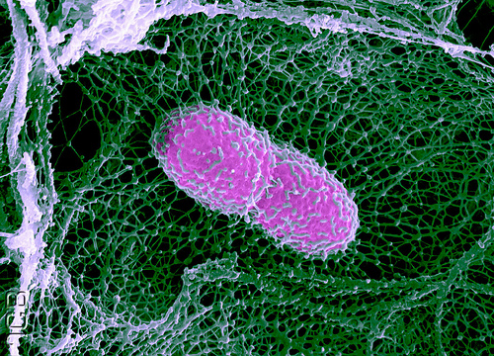
What must get in?
What must get out?
http://www.flickr.com/photos/thejcb/5136606417/

Slide 3
Oxygen
Nutrients
Water
If a cell is too large, the SA:Volume ratio is too small for diffusion to accommodate the requirements of the cell
Carbon Dioxide
Other Waste
Heat
Cell products

Slide 4
So what does a cell do?
When the cell reaches it’s maximum size, the cell will divide into two cells that are identical to each other and to the original cell

Slide 5
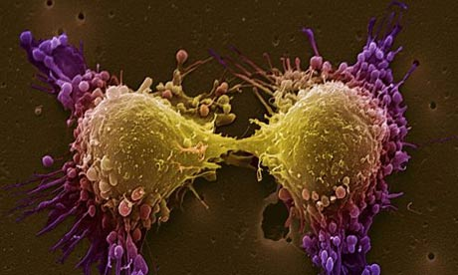
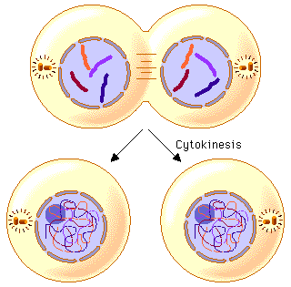
What is mitosis?
Mitosis- is the division of a parent cell to form two identical daughter cells.
Cell Division = the process by which a cell divides into two daughter cells. Before division occurs, a cell copies all of its DNA.

Slide 6
Before the details of mitosis…
Do cells divide all the time?
What factors cause cells to divide?
Do different cells divide differently?
What happens when cells keep dividing when they aren’t suppose to?

Slide 7
What is the cells life cycle?
G1 (Gap 1) Cell Growth
S (Synthesis) - DNA copies
G2 (Gap 2) - cell prepares for division and continues to grow
M (Mitosis)- Cell condenses and separates DNA and begins to pull apart.
Cytokinesis- Cell splits.

Slide 8
Cells spend 90% of their time in Interphase. So what causes cells to divide?
Single Cell Organisms
Multi-cellular Organisms
Reproduction
Growth
Repair
Note: multi-cellular organisms reproduce through a separate cellular division process called meiosis (we will cover that next unit!)

Slide 9
For single celled organisms…
Reproduction

Slide 10
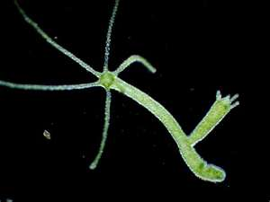
What is Asexual Reproduction?
Mitosis is a type of asexual reproduction.
Asexual reproduction is a mode of reproduction by which offspring arise from a single parent
Offspring have 100% of the DNA of the parent, in other words, they are exact “clones” of the parent cell
Unicellular (one celled) organisms use mitosis to reproduce.
Example: Hydra budding.

Slide 11
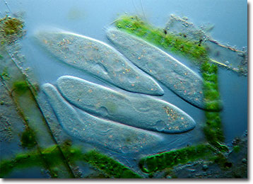
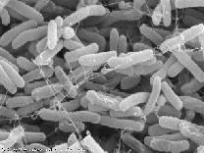
Asexual Reproduction
Two major types, Mitosis and Binary Fission
Mitosis occurs in eukaryotes, binary fission occurs in prokaryotes
Binary fission is the same process as mitosis except because there are no organelles in prokaryotes, it occurs faster
Examples of binary fission: bacteria and protists

Slide 12
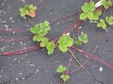
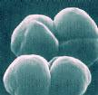
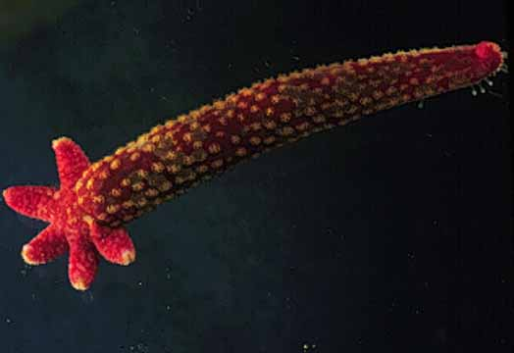
Asexual Reproduction
Examples of organisms that reproduce asexually
Hydra
Sea Star
Strawberry
Archaebacteria
Eubacteria
Euglena
Paramecium
Yeast

Slide 13
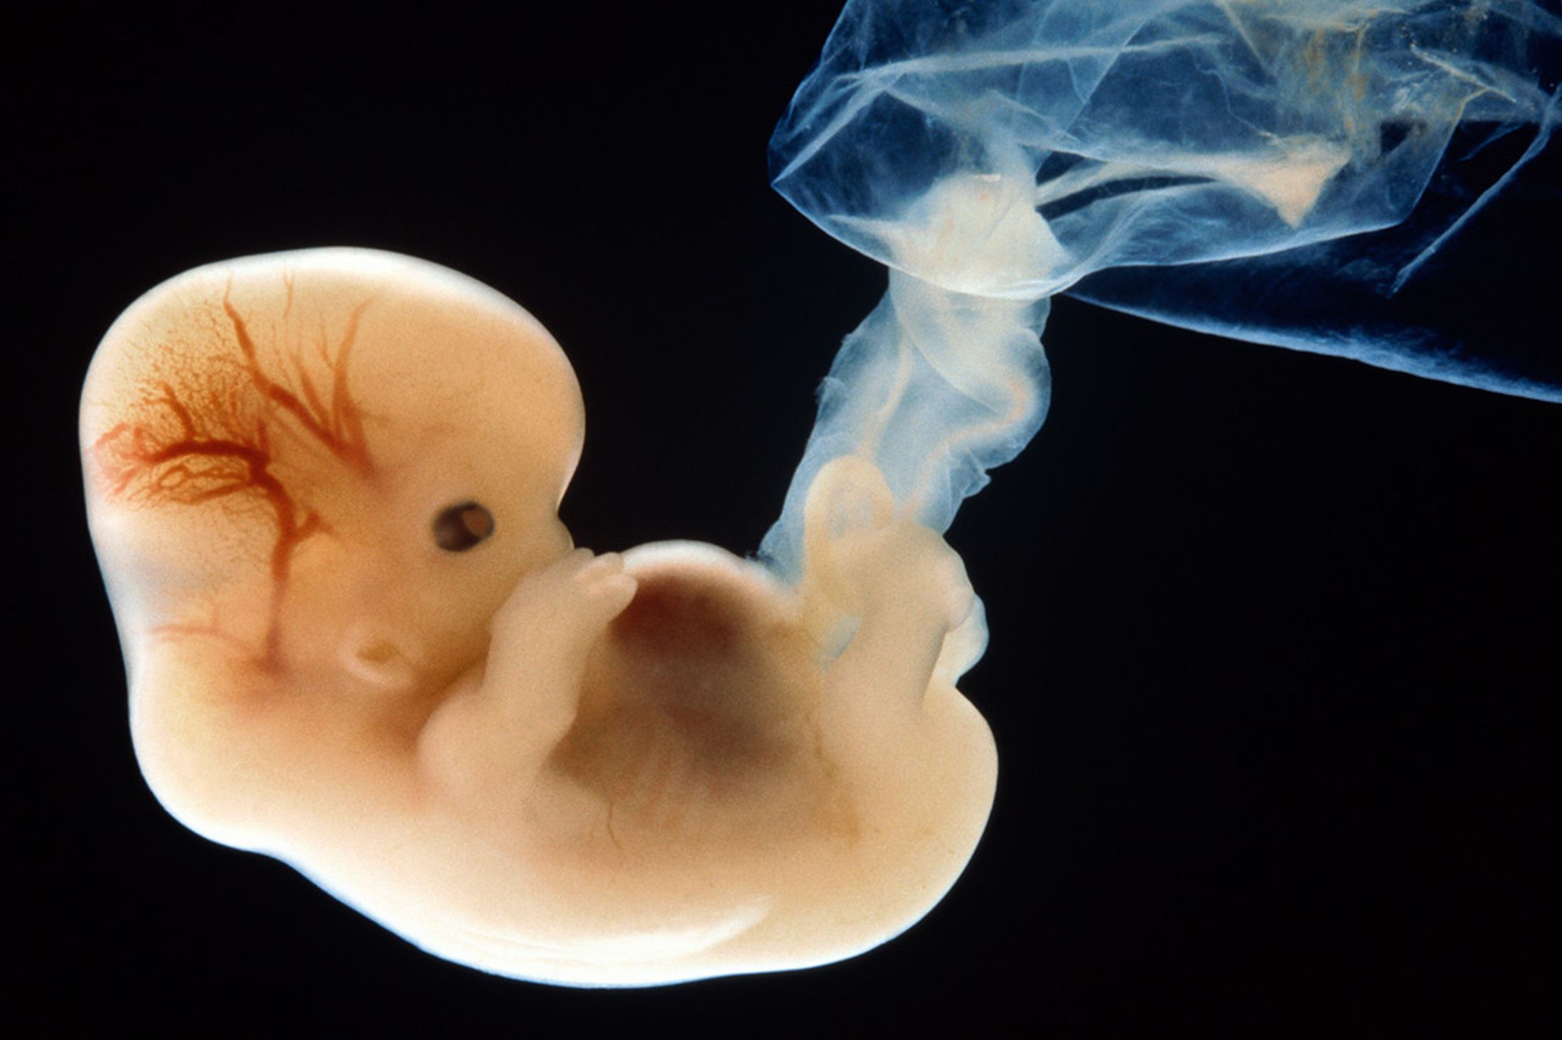
For multi-cellular organisms….
Growth
Repair

Slide 14
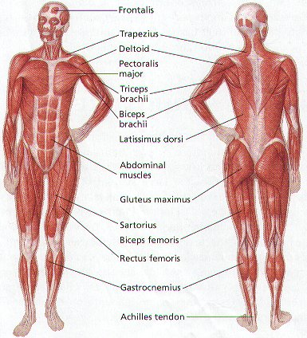
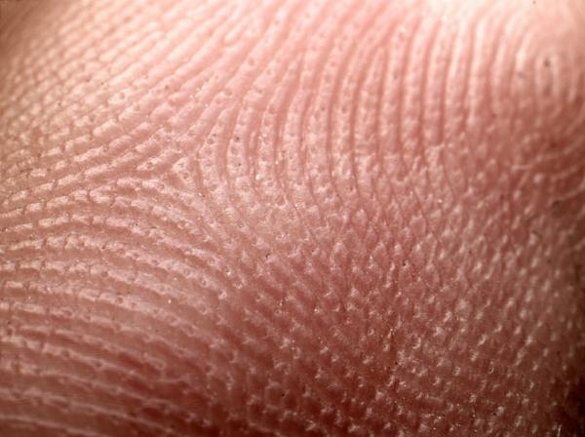
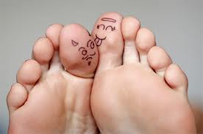
Where does mitosis occur?
Mitosis occurs in somatic cells - Somatic cells are body cells or any cell besides sex cells (gametic cells or gametes: sperm and eggs)
Hint: “MY-TOE-SIS”

Slide 15
Do different cells divide differently?
Different kinds of cells divide at different rates and different amounts
Skin cells divide about every 24 hours
Nerve cells never divide after reaching maturity (think about someone who is paralyzed)
Every cell only has a certain number of divisions it can go through before it dies in programmed cell death called apoptosis

Slide 16
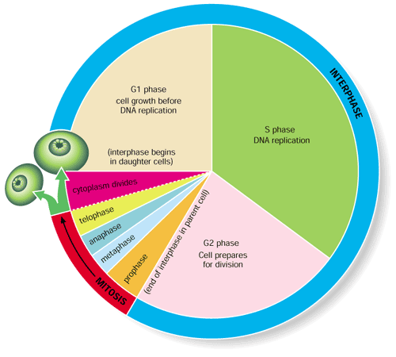
What controls if cells divide?
Mitosis is regulated by hormones in the body and in individual cells
There are several “checkpoints” in the cell cycle to make sure the cell is doing what it is suppose to be doing

Slide 17
What if it all goes wrong?
Cancer is uncontrolled cell growth

Slide 18
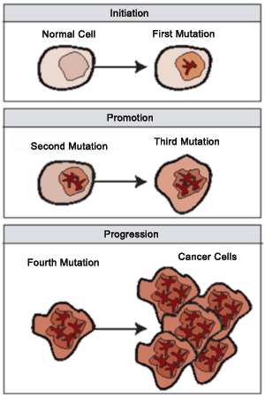
Cell Division Control
DNA controls all cell activities including cell division
Some cells lose their ability to control their rate of cell division – the DNA of these cells has become damaged or changed (mutated)
These super-dividing cells form masses called tumors

Slide 19
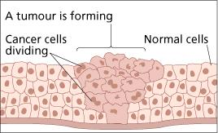
Benign tumors are not cancerous – these cells do not spread to other parts of the body
Malignant tumors are cancerous – these cells break loose and can invade and destroy healthy tissue in other parts of the body (called metastasis)

Slide 20
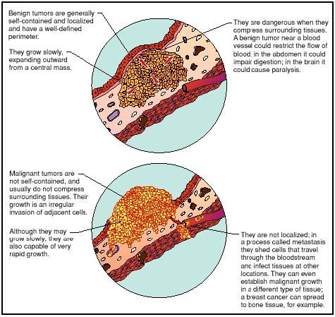

Slide 22
Key Points
Mitosis is a part of asexual reproduction.
Mitosis produces 2 identical daughter cells.
During Mitosis, DNA is replicated and divided so each cell has an exact copy.

Slide 23
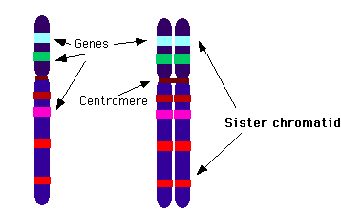
How is the DNA bundled for Mitosis?
Did you know! Humans have 23 pairs of chromosomes!
Chromatid- a strand of DNA
Chromosome: DNA condensed and “knit” together.
Centromere: Area where chromosomes are attached
Diploid- Having a copy of each chromosome.
How many total chromosomes do we have???

Slide 24
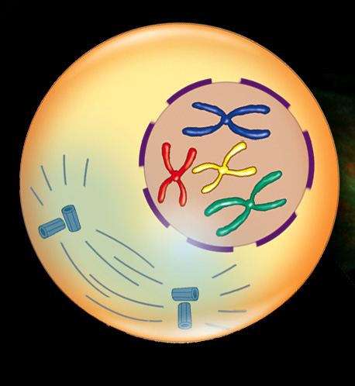
Stage 1 (I) PMAT
Prophase
Spindle fibers form
Centrioles move to opposite poles
Chromosomes condense and become visible
Spindle fibers
Centrioles

Slide 25
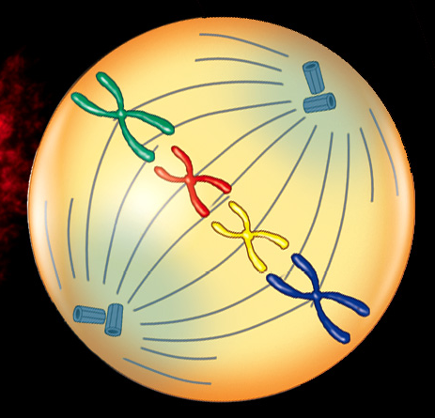
Stage 2 PMAT
**** Hint: think M=Middle
Metaphase
Chromosomes line up along the middle.

Slide 26
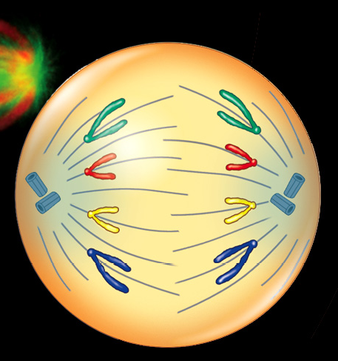
What are the stages of mitosis? Stage 3 PMAT
Anaphase
Sister Chromatids separate and move to opposite poles
**** Hint: think A= Apart
For Anaphase

Slide 27
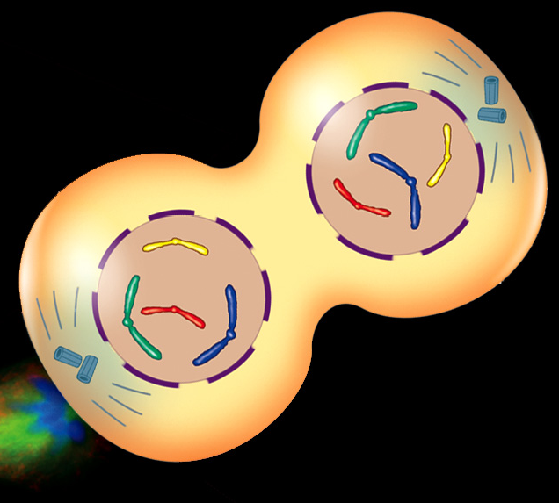
PMAT Stage 4
Telophase
Nuclear membrane reforms
Chromosomes unwind
Two daughter cells
*** Hint: think Telo= means end.

Slide 28
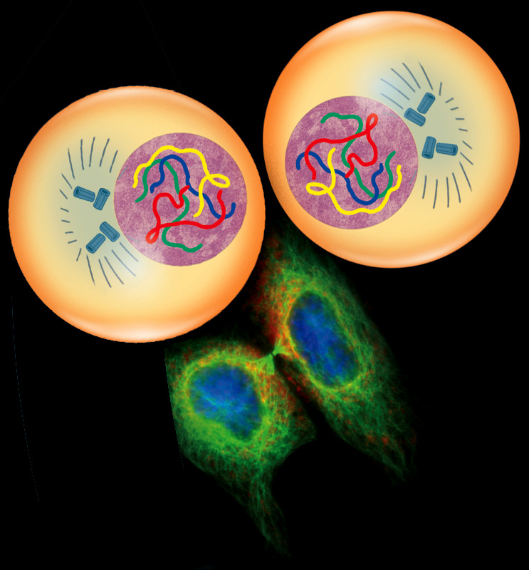
Cytokinesis
Cytokinesis - The cytoplasm divides and one cell becomes two individual cells. The process is different in plants and animals

Slide 29
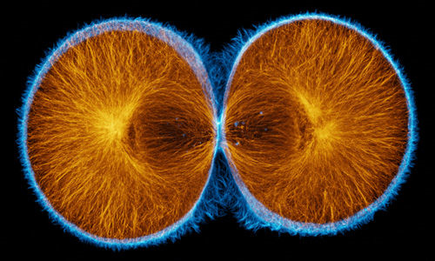
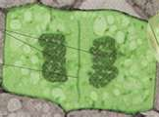
What are the stages of mitosis? Stage 5
Which one is the plant cell? Which one is the animal cell?

