Slide 1
Day one of Meiosis

Slide 2
Bell Ringer on page 49 in journal:
How are sexual reproduction and asexual reproduction different from each other?
A. sexual reproduction requires two parents and asexual reproduction requires only one parent
B. asexual reproduction requires two parents and sexual reproduction requires only one parent
C. mutation rates are lower in sexual reproduction than in asexual reproduction
D. asexual reproduction occurs only in multicellular organisms

Slide 3
Take Cornell notes!!! On page 50
https://www.youtube.com/watch?v=toWK0fIyFlY

Slide 4
KEY CONCEPT Gametes have half the number of chromosomes that body cells have.

Slide 5
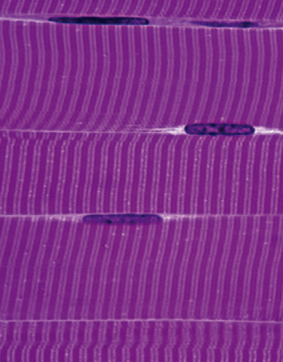
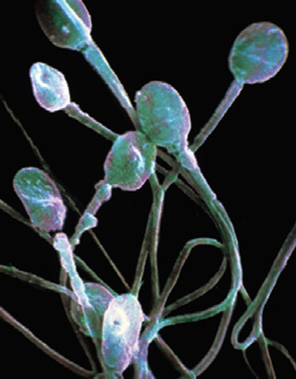
You have body cells and gametes.
Body cells are also called somatic cells.
Germ cells develop into gametes.
Germ cells are located in the ovaries and testes.
Gametes are sex cells: egg and sperm.
Gametes have DNA that can be passed to offspring.
body cells
sex cells (sperm)
sex cells (egg)

Slide 6
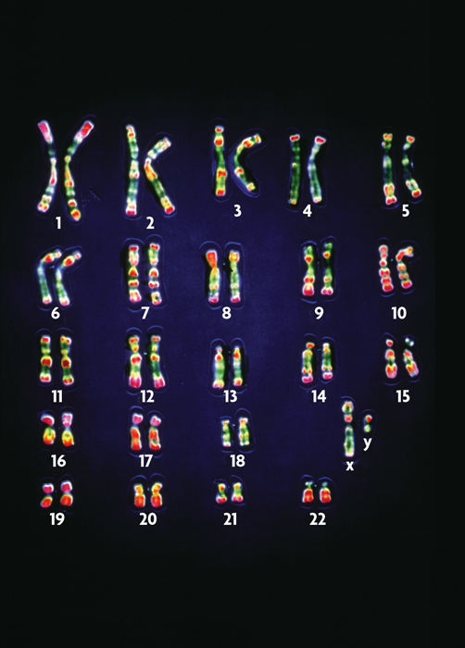
Your cells have autosomes and sex chromosomes.
Your body cells have 23 pairs of chromosomes.
Homologous pairs of chromosomes have the same structure.
For each homologous pair, one chromosome comes from each parent.
Chromosome pairs 1-22 are autosomes.
Sex chromosomes, X and Y, determine gender in mammals.

Slide 7
Higher order thinking #1
How does cellular information pass from one generation to another?

Slide 8
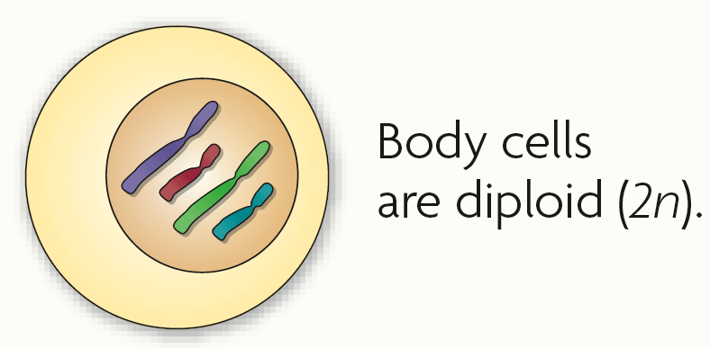
Body cells are diploid; gametes are haploid.
Fertilization between egg and sperm occurs in sexual reproduction.
Diploid (2n) cells have two copies of every chromosome.
Body cells are diploid.
Half the chromosomes come from each parent.

Slide 9
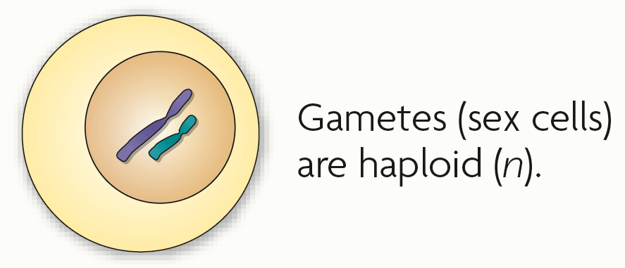
Haploid (n) cells have one copy of every chromosome.
Gametes are haploid.
Gametes have 22 autosomes and 1 sex chromosome.

Slide 10
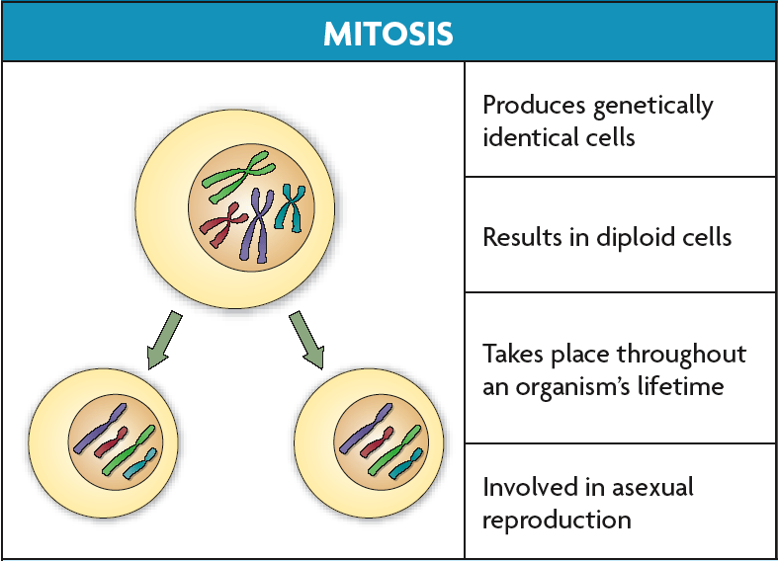
Chromosome number must be maintained in animals.
Many plants have more than two copies of each chromosome.
Mitosis and meiosis are types of nuclear division that make different types of cells.
Mitosis makes more diploid cells.

Slide 11
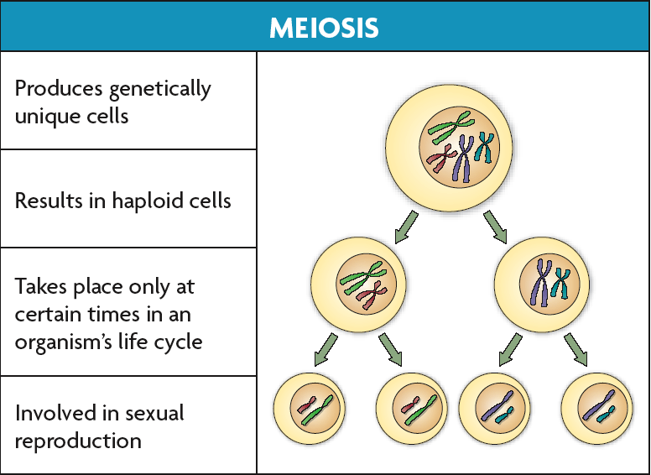
Meiosis makes haploid cells from diploid cells.
Meiosis occurs in sex cells.
Meiosis produces gametes.

Slide 12
Higher order thinking #2
Explain why chromosomes, not genes, independently assort.

Slide 13
KEY CONCEPT During meiosis, diploid cells undergo two cell divisions that result in haploid cells.

Slide 14
Cells go through two rounds of division in meiosis.
Meiosis reduces chromosome number and creates genetic diversity.

Slide 15
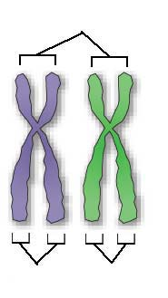
Meiosis I and meiosis II each have four phases, similar to those in mitosis.
Pairs of homologous chromosomes separate in meiosis I.
Homologous chromosomes are similar but not identical.
Sister chromatids divide in meiosis II.
Sister chromatids are copies of the same chromosome.
homologous chromosomes
sister
chromatids
sister
chromatids

Slide 16
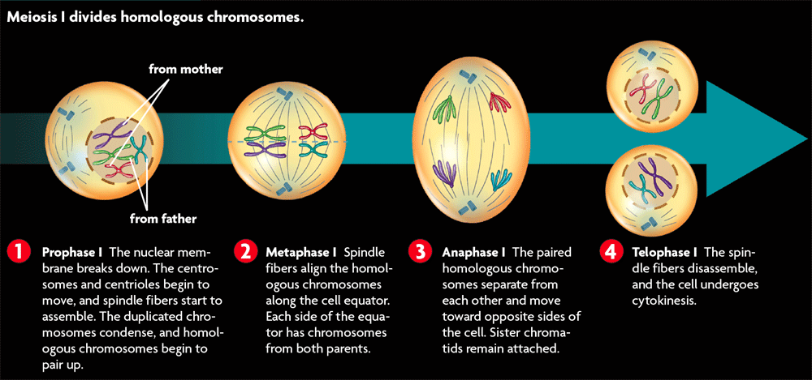
Meiosis I occurs after DNA has been replicated.
Meiosis I divides homologous chromosomes in four phases.

Slide 17
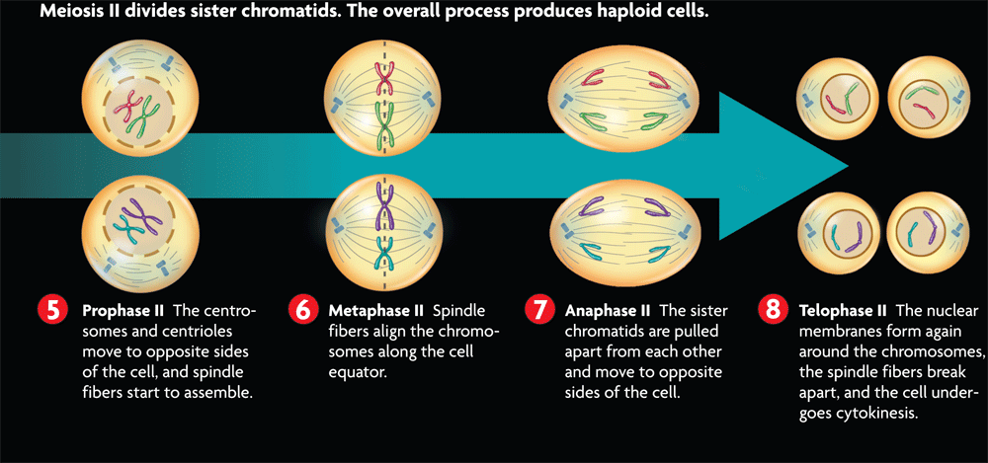
Meiosis II divides sister chromatids in four phases.
DNA is not replicated between meiosis I and meiosis II.

Slide 18
Meiosis differs from mitosis in significant ways.
Meiosis has two cell divisions while mitosis has one.
In mitosis, homologous chromosomes never pair up.
Meiosis results in haploid cells; mitosis results in diploid cells.

Slide 19
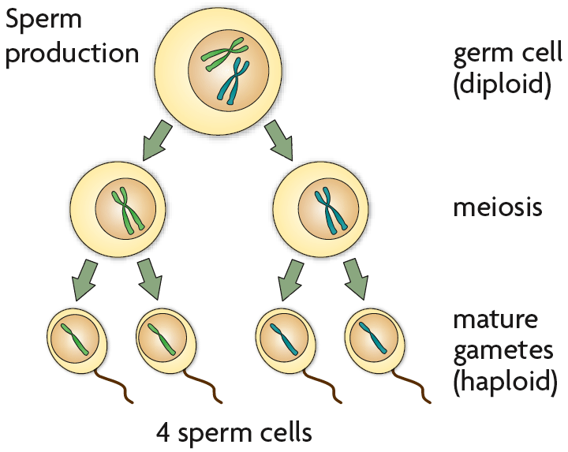
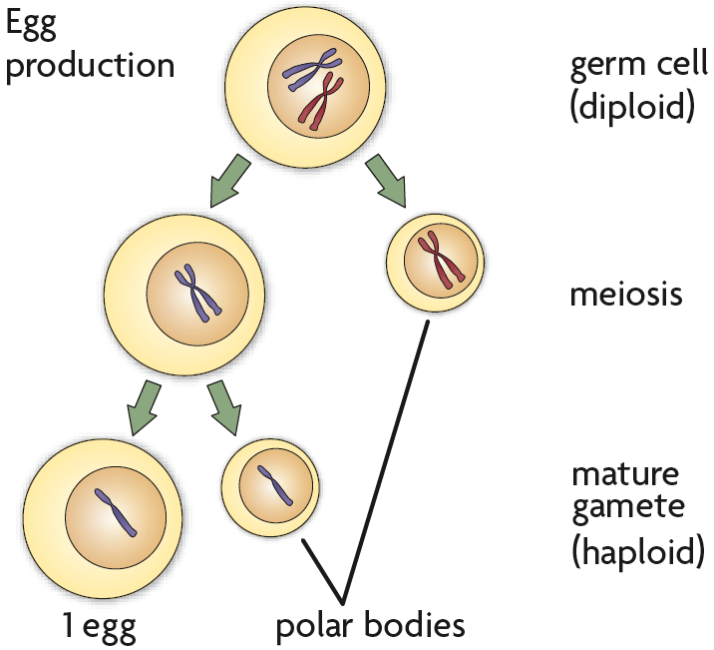
Haploid cells develop into mature gametes.
Gametogenesis is the production of gametes.
Gametogenesis differs between females and males.
Sperm become streamlined and motile.
Sperm primarily contribute DNA to an embryo.
Eggs contribute DNA, cytoplasm, and organelles to an embryo.
During meiosis, the egg gets most of the contents; the other cells form polar bodies.

Slide 20
Higher order thinking #3
How can we use genetics to study human inheritance?

Slide 21
Venn Diagram on page 49
Meiosis Mitosis

Slide 22
Flip Chart it! On page 49
Cut out each square
Draw each stage of meiosis in the “cells”
Staple the pages together to create a flipchart of meiosis

Slide 23
Essential Question on page 50
How does the sorting and recombination of genes in sexual reproduction result in a great variety of possible gene combinations?

Slide 24
Home Learning
SCIENCE FAIR report due 11/22
Afterschool help 11/17 for science fair

Slide 25
Day two on Meiosis

Slide 26
Bell ringer on page 51 in journal:
How are mitosis and meiosis different from each other?

Slide 27
Take Cornell Notes!!! On page 52
https://www.youtube.com/watch?v=gcz1FOWw0Cg

Slide 28
KEY CONCEPT Independent assortment and crossing over during meiosis result in genetic diversity.

Slide 29
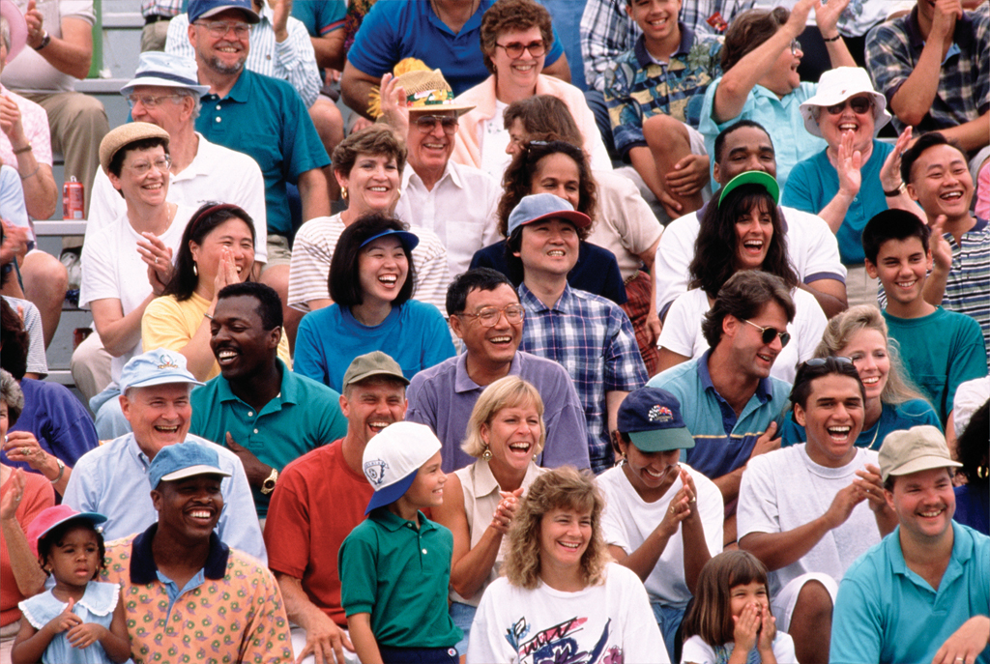
Sexual reproduction creates unique combinations of genes.
Sexual reproduction creates unique combination of genes.
independent assortment of chromosomes in meiosis
random fertilization of gametes
Unique phenotypes may give a reproductive advantage to some organisms.

Slide 30
Crossing over during meiosis increases genetic diversity.
Crossing over is the exchange of chromosome segments between homologous chromosomes.
occurs during prophase I of meiosis I
results in new combinations of genes

Slide 31
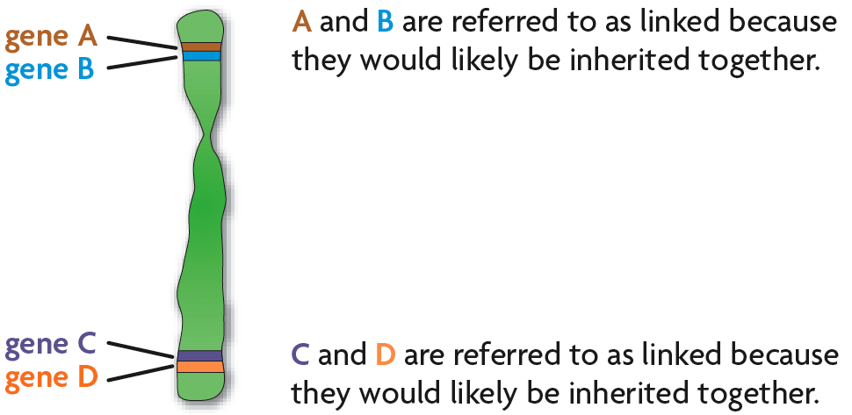
Chromosomes contain many genes.
The farther apart two genes are located on a chromosome, the more likely they are to be separated by crossing over.
Genes located close together on a chromosome tend to be inherited together, which is called genetic linkage.
Genetic linkage allows the distance between two genes to be calculated.

Slide 32
Higher order thinking #4:
What is the relationship between meiosis and genetic disorders such as Down’s Syndrome and Turner’s Syndrome?

Slide 33
Lab Time!!!! On page 51
Follow all directions carefully
Leave your area clean, there should be no pop beads on the ground when you are finished
Answer the questions in your notebook

Slide 34
Anchor chart- write down on page 52 in journal, use color!

Slide 35
Home Learning
SCIENCE FAIR report due 11/22
Afterschool help 11/17 for science fair
STUDY for meiosis and mitosis quiz next class (11/22)

