Slide 1
Do Now: Choose one of the three ideas that make up the cell theory and come up with an analogy. Be Ready to share out.
Example:
Cells are the basic unit of life.
Bricks are the basic unit of a building.

Slide 2
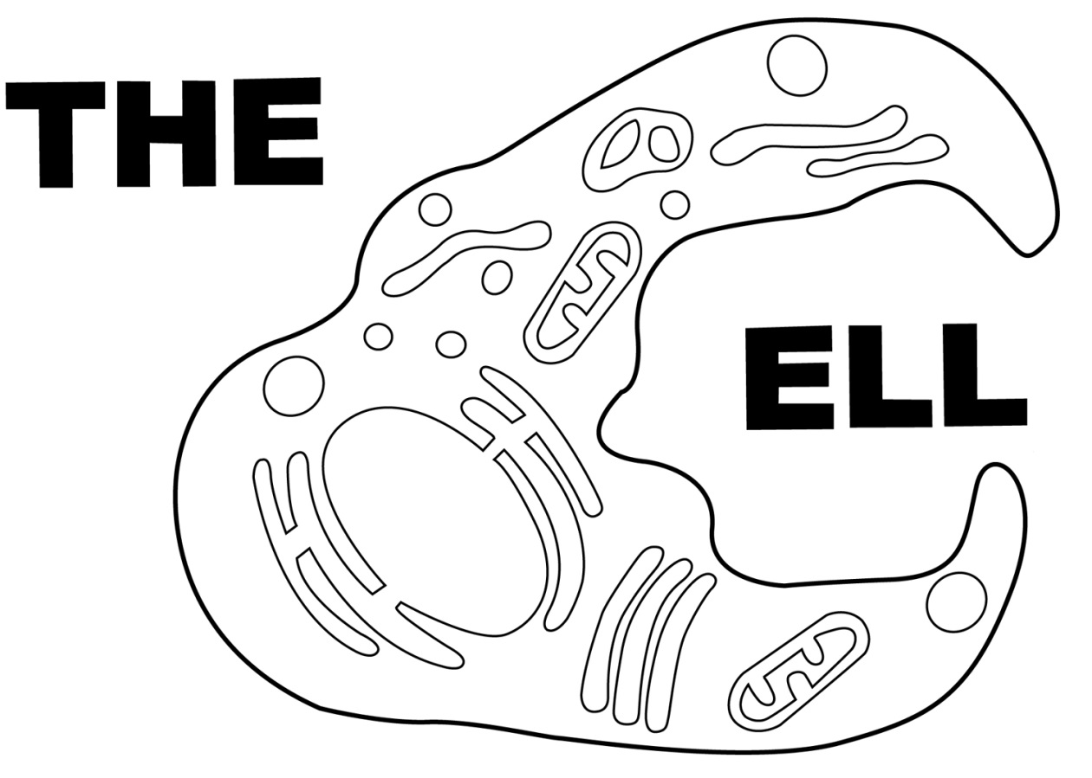
Day 1 of….

Slide 3
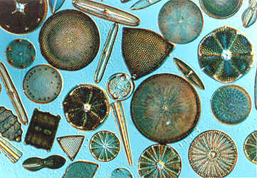
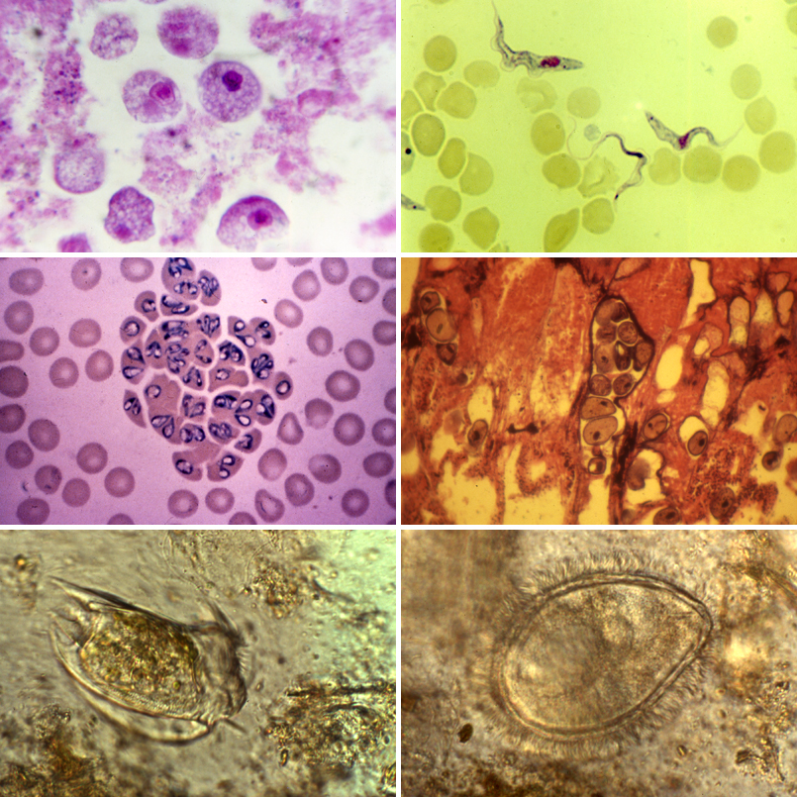
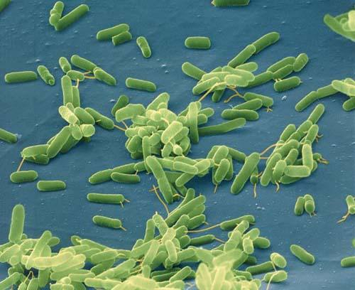
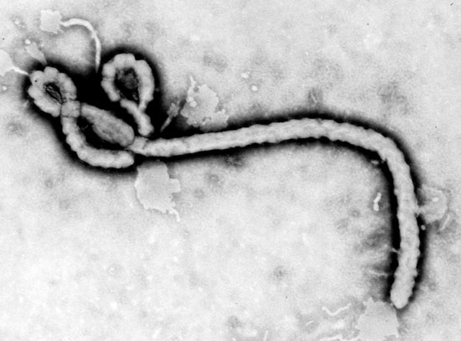
Unicellular Organisms

Slide 4
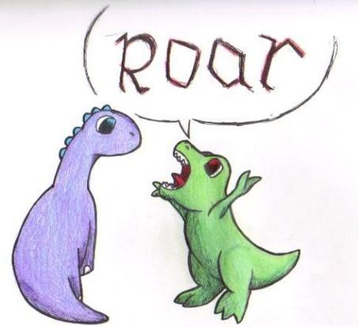
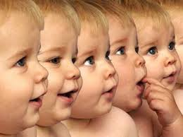
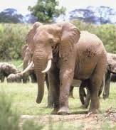

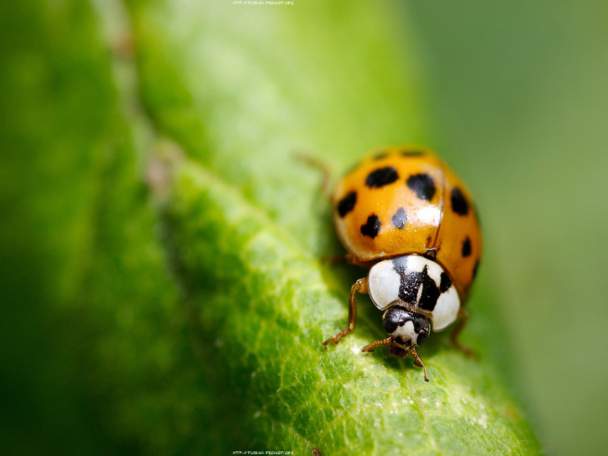
Multi-cellular Organisms

Slide 5
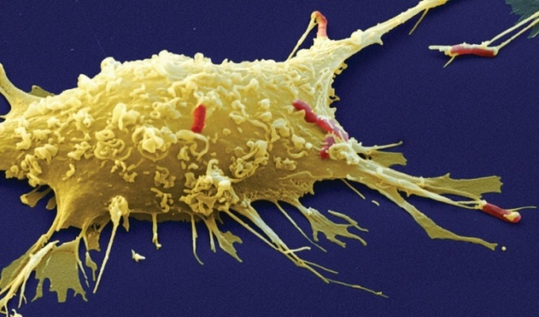
Two Types of Cells
Prokaryotic and Eukaryotic:
“Pro” means “before”
“Karyon” means nucleus
“Eu” means “true”
So what does Prokaryotic mean?
What does Eukaryotic mean?

Slide 6
This is a Eukaryotic Cell
nucleus
organelles

Slide 7
This is a Prokaryotic Cell

Slide 8
Eukaryotic
DNA
cytoplasm
Cell Membrane
Prokaryotic

Slide 9
All Cells Have:
Membrane
Cytoplasm
Similar Building Blocks
  DNA
  Ribosomes

Slide 10
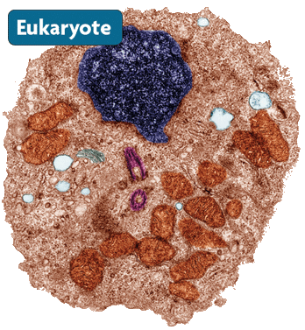
Eukaryotic Cells
  Larger and more complex
  Eukaryotic cells have a nucleus and membrane-bond organelles
  Example: Plant and animal cells.
nucleus
organelles
cell membrane

Slide 11
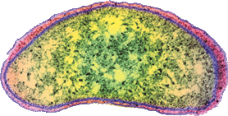

Prokaryotic Cells
  Smaller and simpler.
  Prokaryotic cells do not have a nucleus.
  Prokaryotic cells do not have membrane-bound organelles.
  Example: bacteria
nucleus
organelles
cell membrane
cytoplasm
Notes:
Compare the simplicity of the two

Slide 12
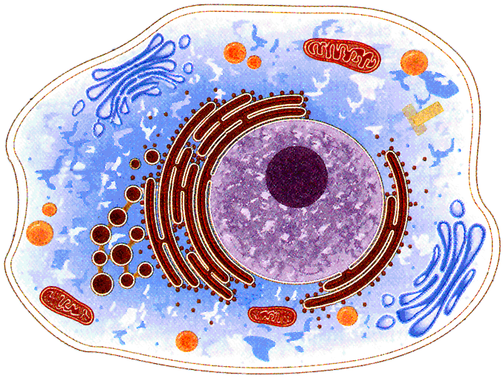
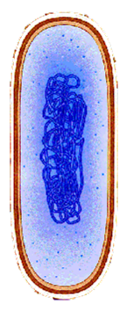
Eukaryotic Cell vs. Prokaryotic cell

Slide 13
Video Break
https://www.youtube.com/watch?v=ss19u6vJNNQ
0:00 to 4:25
Listen to the video and fill in the questions on your note sheets. I will call on random people to answer the questions for participation points!

Slide 14
Check for Understanding 1
  Which statement is TRUE?
  All cells contain membrane-bound organelles.
  All uni-cellular organisms have specialized cells to perform life’s functions.
  All cells come from other pre-existing cells.
  All cells arise from inorganic materials through spontaneous generation.
Notes:
C

Slide 15
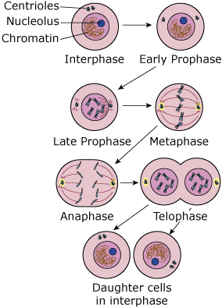
Check for Understanding 2
What part of cell theory is the diagram to the right evidence of?
Notes:
Cells come from pre-existing cells.

Slide 16
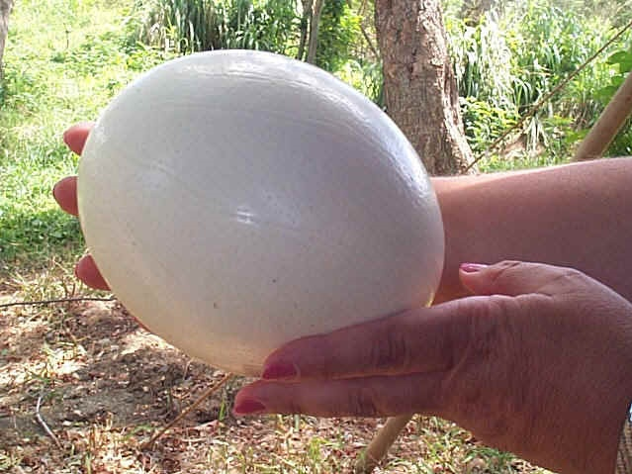
Check for Understanding 3
Are all cells microscopic?
  If yes, explain why.
  If no, provide an example.
An ostrich egg is a single cell and is the biggest cell known!
Notes:
NO… eggs

